Slide 1
Ibaadah Friendly Hospital Services, A Call To Action
PROF. H. UMAR SULAYMAN
(MBBS, FWACS, FMCOG, FICS, FMAS, DMAS,DRH, PGDM, LMIH, PF-IART)
CONSULTANT OBGYN,IMAN DEPUTY EDITOR IN CHIEF
AHMADU BELLO UNIVERSITY TEACHING HOSPITAL, ZARIA.
IMAN OGUN STATE AGM & SCIENTIFIC CONFERENCE, 29TH RABIUL AWWAL 1445AH
(14TH OCTOBER 2023)

Slide 2
CONTENT
INTRODUCTION
CONCEPT OF IBADAH-FRIENDLY HOSPITAL (IFH)
HISTORY OF IBADAH-FRIENDLY HOSPITAL (IFH)
IMPLEMENTATION OF IFH
MAQAASIDU SHARI’AH (PURPOSE OF SHARIAH)
THE CONCEPT OF RUKHSAH AND DHARURAH
OBLIGATIONS OF THE HOSPITAL ADMINISTRATION
STANDARD OPERATING PROCEDURES
PRACTICAL APPLICATION OF IBADAH FRIENDLY HOSPITAL CONCEPT
SUMMARY & CONCLUSION

Slide 3
INTRODUCTION
The Qur’an and Sunna are sources of guidance to every Muslim and offers flexibility and leniency in certain circumstances so as not to bring hardship to individuals.
Such special conditions include the cases of travellers, the sick and healthcare personnel who are engaged in lengthy medical procedures.
Special exemptions and concessions have been granted to such individuals through the application of the concepts of Rukhsah (linency) and Dharurah, (necessity) and this is the fundamental principle underlying the Ibadah (worship) Friendly Hospital concept.

Slide 4
CONCEPT OF IBADAH-FRIENDLY HOSPITAL (IFH)
Ibadah- Friendly Hospital (IFH) practice enables patients, patient relatives and Muslim health workers to observe their religious obligations properly, especially the five daily prayers while on hospital admission and on duty respectively.
The concept is derived from the Holy Qur'an in Suratul Zariyat, Ayah 56 where Allah (SWT) said He had not created ‘Jinn' and ‘Ins' (mankind) except for His worship (Ibadah).
Adult Muslims are not exempted from the five daily prayers unless they are unconscious or insane.
وَمَا خَلَقْتُ الْجِنَّ وَالإِنسَ إِلاَّ لِيَعْبُدُون
‘And I created not the Jinn and mankind except that they should worship Me.’

Slide 5
Goals of Ibadah-Friendly Hospital (IFH)
Primary goals:
Achievement of success in the present life and in the hereafter and the attainment of Mardhatullah (pleasure of Allah(SWT).
For Muslim health care workers, patients, relatives and those immediately involved in the patient care to get closer to Allah.
Enable people to perform their duty as Khalifah (Vicegerents) of Allah on earth.
Enable people to maintain their relationship with Allah while undergoing trials like that of ill health.

Slide 6
Why the need for Ibadah-Friendly Hospitals (IFH)?
Some studies in the Muslim world found that over 30% of hospitalized patients do not perform the five daily prayers consistently.
Another study estimates that up to 80% of patients in the ward do not perform their salat in one of the government hospitals in Malaysia; and in Nigeria 31.3% of patients reported not praying while on admission (Salisu et al.)
The major reasons being:
Ignorance from the patients and relatives regarding performing prayers while ill.
Inability of the hospital management to provide the basic facilities which assist patients in performing Salat (obligatory prayers).
Lack of support by the medical staff on duty.

Slide 7
Why the need for Ibadah-Friendly Hospitals (IFH)?
Based on the above findings, it then became imperative that the Muslim health care workers need to do more in supporting and encouraging their patients on admission to perform the five daily prayers consistently.
Rasulullah (SAW) said:
“And Allah helps his servant, as long as the servant helps others"
(Imam An-Nawawi hadith 36).

Slide 8
Relevant Questions regarding IFH
How many of our Muslim patients perform their salat while they are under our care?
Who is responsible in helping Muslims patients perform their salat?
Have we ever discussed Islam or spirituality with the non-Muslims patients ?
Have we ever assisted terminally ill patients under our care in the final seconds of their life?

Slide 9
HISTORY OF THE CONCEPT OF IBADAH-FRIENDLY HOSPITAL (IFH)
Under the guidance of Prof Ali Mish’al (Al marhuum) , a renowned Physician and Islamic scholar, The Islamic Hospital of Jordan was built as a charity, non-profit training medical institution, which started operations in 1982.
This hospital combines up-to-date medical facilities with the Islamic elements in the running of the hospital and had set an excellent exemplary model for Muslim hospitals in recent years.
The development of the Ibadah Friendly Hospital and the Shariah Compliant Hospital stemmed from the Islamic Hospital of Jordan.
Dr Ishak Mas’ud of Malaysia and his team developed this concept further and made the concept popular through various presentations all over the world.
Nigeria embraced the concept since 2016 when we hosted the FIMA conference in Abuja.

Slide 10
IFH Worldwide Program

Slide 11
The Islamic Hospital of Jordan in Amaan.

Slide 12
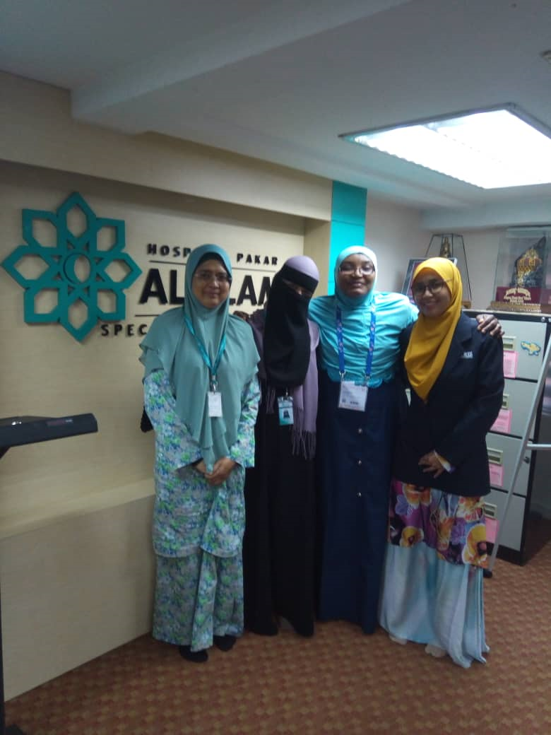
Al Islam Hospital, Kuala Lumpur, Malaysia.

Slide 13
IMPLEMENTATION OF IFH
The pre-requisite to the proper implementation of IFH practice include understanding the followings:
Understanding Islam as of complete way of life.
Knowing the concept of Ibadah (worship) in Islam.
Understanding the application of Maqasid as-shar’iyya (purpose of Islamic rulings) and Qawaid Al-fiqihiyyah (Islamic jurisprudence).
Having the knowledge of Islamic Medical Ethics.
Understanding the concept of Rukhsah (linency) and Dharurah (necessity) for Medical staff and patients.
Understanding the various ways in which patients can carry out acts of worship.
Acknowledging the importance of visiting the sick as a means of gaining rewards from Allah (SWT).

Slide 14
Maqaasidu Shari’ah (Purpose Of Shariah)
The purpose of Shari’ah in Islam is for the protection and preservation of human life. The five components of Shari’ah as agreed by the majority of Islamic Scholars are as follows:
To Preservation of Religion حفظ الدي ن
To Preservation of Life حفظ النف س
To Preservation of Intellect حفظ العق ل
To Preservation of Progeny حفظ النس ل
To Preservation of Wealth ل حفظ الما

Slide 15
Maqaasidu Shari’ah (The purpose of Shari’ah)
Preservation of Religion: Providing all the necessary support to enable individuals to perform his/her religious obligations such as observing the five obligatory daily prayers as prescribed by Allah (SWT), giving patients information of the need and necessity to perform Salat and creating the enabling environment to do so like tayammum.
Preservation of Life: Ensuring that adequate and proper care is given to patients with the aim of sustaining life according to established medical principles which does not contradict the shari’ah. This includes maintaining quality of life till death.

Slide 16
Maqaasidu Shari’ah (The purpose of Shari’ah)
Preservation of Intellect: Providing appropriate mental health services while upholding the principles governing Islamic spiritual care that links the patient’s thought to Allah Almighty, his creator in all his/her affairs. It includes perseveration of emotional and psychological wellbeing.
Preservation of Progeny: Entails proper reproductive health services to all Muslim patients and clients according to the principles of Islamic Medical ethics. In the field of assisted reproductive technology, it involves a Muslim health worker ensuring that the sperm and ova comes from a husband and his wife and not from donors since this is prohibited (haram).

Slide 17
Maqaasidu Shari’ah (The purpose of Shari’ah)
Preservation of Wealth: Avoiding wastages and embezzlement of patient’s wealth while rendering service to him/her and making necessary adjustments to conserve patient’s/client’s finances.

Slide 18
The Concept of Rukhsah and Dharurah
Dharurah means a situation that would necessitate the use of an otherwise forbidden action or thing.
Rukhsah is defined as temporary permission of an otherwise non-permissible or prohibited action or substance in a particular situation as per the essential requirements, in the larger interest of the human being.
The main purpose of both is the application of Maqasid Ash-Shari’ah as described above.

Slide 19
The Concept Of Rukhsah And Dharurah
Islam is a practical religion and creates ease for human beings and reduces hardship as much as possible. This is seen in several Ayaats verses of the Qur’an:
لَا يُكَلِّفُ اللهُ نَفْسًا إِلَّا وُسْعَهَا
“Allah does not lay a responsibility on anyone beyond his capacity.”
(Suratul Baqarah Ayah 286)
يُرِيدُ اللهُ أَن يُخَفِّفَ عَنكُمْ وَخُلِقَ الْإِنسَانُ ضَعِيفًا
“Allah wants to lighten your burdens, for man was created weak.”
(Suratul Nisa Ayah 28).

Slide 20
The Concept Of Rukhsah And Dharurah
From the Sunna:
Rasulullah(SAW) stated in the following hadith:
a. ‘Create easiness and do not create hardship and spread good news
and not bad news’ (Bukhari).
b. ‘The religion that Allah likes the most is the one that is straight
forward and easy’ (Bukhari).
c. ‘The best of religion is its easiness and concessions.’ (Musnad
Ahmad).

Slide 21
The Concept of Rukhsah and Dharurah
In normal situation (Azimah) all Muslims should follow the usual guidelines regarding performing salat within the specified periods.
However, in certain situations called Dharurat, then the concept of Rukhsah is applicable especially for patients.
The most frequent situation is salat for patients in the ward i.e., they can do jama’ prayer combining Zuhur and Asar or Maghrib and Ishaa’a.
Other situations include the use of Tayammum replacing wudhu if the condition prohibits the use of water.
This is an essential concept which needs to be understood in depth by Muslim healthcare givers if they want to apply the IFH concept.

Slide 22
Obligations Of The Hospital Administration
Establish ibadah related Standards Operating Procedures (SOPs) for all staff, ibadah care, guidance and execution of duties to patients, family members and visitors with supervision.
Ensure that spiritual care or care of the mental health of patients is part of the routine day to day health care given to patients.
Make provision for staff to improve their knowledge on the spiritual care of patients.
Provide information, education and communication materials including audio-visuals to improve the spiritual health of the staff, patients and patient’s relatives.
Allow Muslim chaplains (Imams) to give patient spiritual support during admission and at the time of death.

Slide 23
Obligations of the hospital administration
Provide facilities for:
Places of prayer
Qiblah direction
Reminders, prayer books
Prayer clothes
Prayer mats
Clean floor
Assistance in ablution using water (wudhu), sand/dry ablution (tayammum) and obligatory prayers (salat).

Slide 24
STANDARD OPERATING PROCEDURES-NURSES:
Welcome patients and relatives warmly with respect and a smiling face.
Provide orientation for the patient and their relatives regarding the ward, the facilities available for purification and ablution, where they can perform salat, qiblah direction, etc.
Encourage the patients’ relative to also remind and assist the patient to pray when it is time.
Remind and assist every Muslim patient on admission to perform salat on time.
Assist the elderly and disabled patients to perform ablution and salat.
Change wet dressing or diapers of patients near time of salat and assist them to perform salat.
Remove the intravenous drip of patients temporarily when they need to walk to the toilet and perform ablution.
Ensure that patients with colostomy bags are clean and dry when they want to perform salat.
Encourage patients to continuously engage in zikr (qur’anic recitation, du’a, etc).
Assist patients and their relatives to downloads the Muslim Pro of V- Muslim or other similar Application into the patient’s phone or that of their relatives with reminders set for prayer times.

Slide 25
STANDARD OPERATING PROCEDURES-DOCTORS
Support the spiritual care and counselling of Muslim patients.
Be sensitive on the needs of patients regarding spiritual counselling and visits by religious counsellors.
Assist the patients to recite the Kalima at the time of death.
Remind patients to observe their prayers during ward rounds as a form of spiritual and mental health support to the patients.
Remind relatives to support patients as much as they can during the difficulties of ill health and not increase their worries.
Do not expose patients unduly when examining female patients.
Ensure that a chaperone is available when male doctors are examining female patients.

Slide 26
STANDARD OPERATING PROCEDURES-PHARMACISTS
Be kind, patient and courteous to patients.
Explain the dosing regimens to patients in clear and simple language that they can understand.
Gets feedback from the patient ensuring that they understand the message given.
Be vigilant and pro-active in recognizing and pointing out drugs that may have haram (forbidden) substances.
Inform patients of drugs and side effects which may affect act of ibadah like fasting, etc.
Identify potential and actual Drug therapy problems and resolved them in collaboration with other caregivers.
Inform patients of drugs and their side effects and what they can do to mitigates the effects, without worsening their condition or acts of ibadah such as Salat, fasting, etc.

Slide 27
STANDARD OPERATING PROCEDURES-LABORATORY SCIENTIST
Be kind, patient and courteous to patients.
Explain whatever procedure you will be doing to patients in clear and simple language that they can understand.
Inform patients of the effects any procedure that may affect act of ibadah like fasting, etc.
Do not expose patients unduly when collecting samples.
Ensure that a chaperone is available when taking sample from female patients.
Be professional in all aspects of laboratory procedures.

Slide 28
STANDARD OPERATING PROCEDURES-PATIENT CARE ASSISTANTS
Be kind, patient and courteous to patients and their relatives.
Ensure that patient’s bed linens, personal belongings and environment are kept clean to facilitate ibadah.
Ensure that patients who need assistance by the nurse and relatives get the needed care.
Remind the patients and relatives to perform salat.
Assist patients and their relatives to use the bathroom, perform ablution and perform salat.

Slide 29
SOPs BEFORE SURGERIES AND OTHER PROCEDURES
Encourage patient to engage in remembrance of Allah (zikr) while waiting for the procedure.
Encourage the patient to perform salat before they undergo a prolonged procedure.
Remind the patient to recite kalimatu shahadah before the commencement of anaesthesia.
Ensure that the patients are not unduly exposed.

Slide 30
SOPs IN THE MATERNITY WARDS:
The health worker should remind and help the mother to perform ablution and salat when in labour before delivery.
Ensure that the patients are not unduly exposed while in labour.
Ensures that the mother recites zikr and du’a during labour.
The midwife should deliver the babies while reciting ‘Bismillah’.
Assist the guardian or father of the baby to have adhan and iqamah recited in each ear soon after birth.
The Midwife/Nurse should assist the mother to cover her aurah (privacy) while breast feeding.
Remind a woman in labour that despite the pains and draining liquor she must make effort to pray in as far as there is no bleeding. She will stop obligatory salat when she sees blood.
Remind a woman that she must pray (and perform other ritual duties) when menstrual flow exceeds fourteen days.

Slide 31
SOPs FOR THE TERMINALLY ILL & END OF LIFE CARE:
The health care worker should consult the family members and give them appropriate information regarding the condition of the patient.
The health care worker should comfort the terminally ill patient and ensure that some relatives are around to give moral and emotional support.
The patient should be encouraged to pray if still conscious and alert at the time of salat.
The modesty and privacy of the terminally ill should be ensured at all times.
The relatives should be encouraged to recite Qur’an and other zikr and pray for the patient.
The health care worker should remind the patient to recite the kalimatu shahadah at the time of death.
After a patient dies, the healthcare worker should cover the face and body and turn the body to face qiblah.
The health care worker should facilitate the bathing and shrouding of the dead as well as ensuring that the Janaza is not delayed.

Slide 32
PRACTICAL APPLICATION OF IBADAH FRIENDLY HOSPITAL CONCEPT

Slide 33
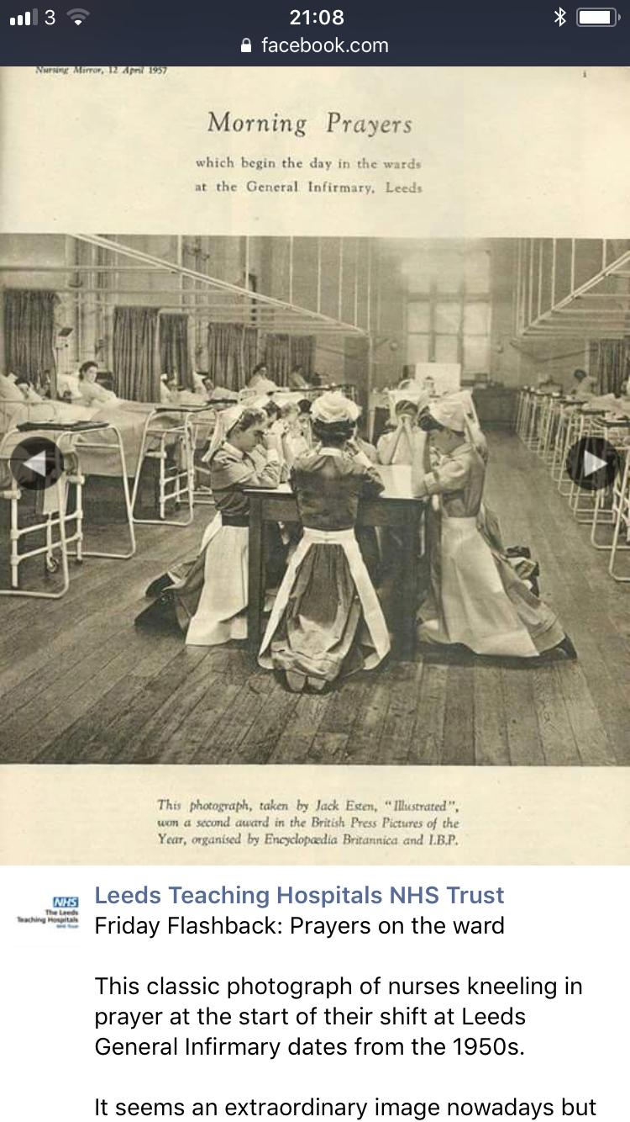

Slide 34
INDONESIA

Slide 35
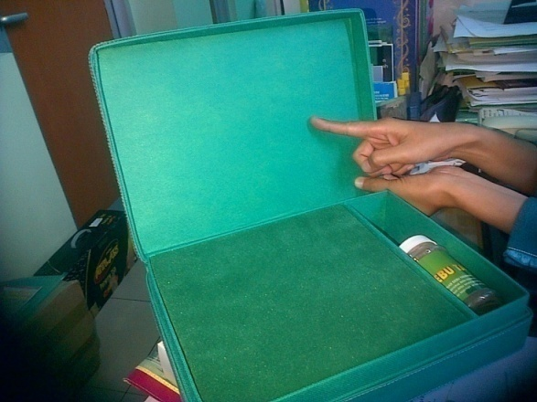
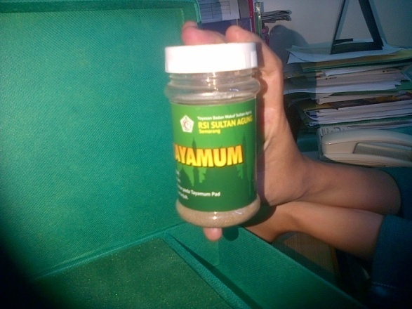
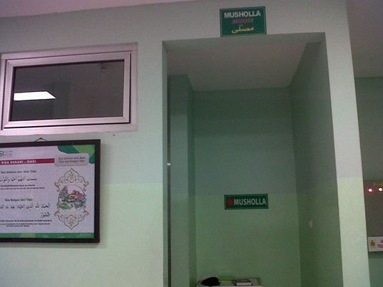
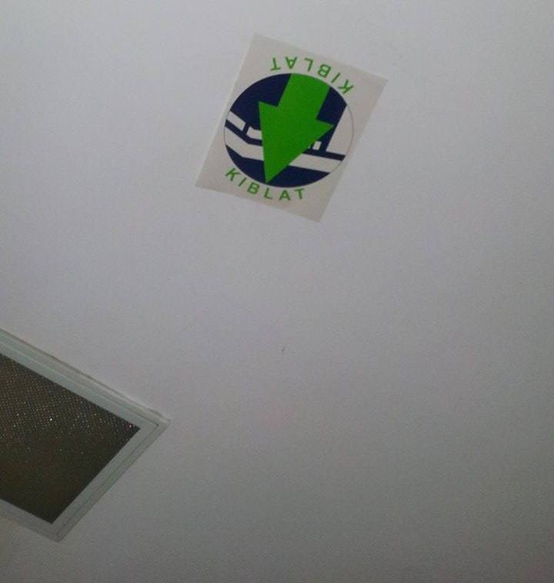
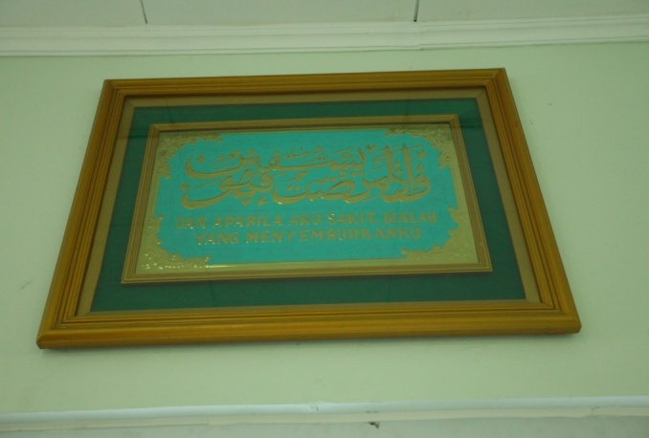
Tayamum Pad
Tayamum Dust
Mosque for Patient’s family
Qiblat Direction
Caligraph of Du’a

Slide 36
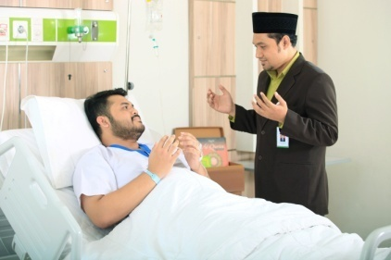
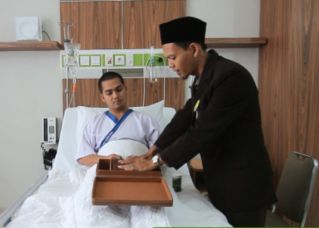
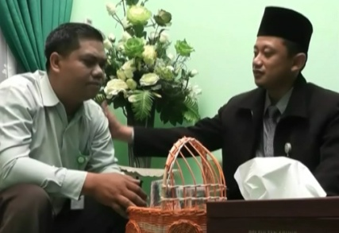
Ibadah Healthcare Services
PENDAMPINGAN IBADA
Couselling during hospitalization
IBADAH counseling
Religion consultation

Slide 37
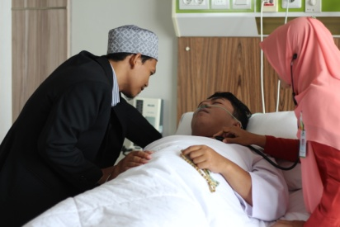
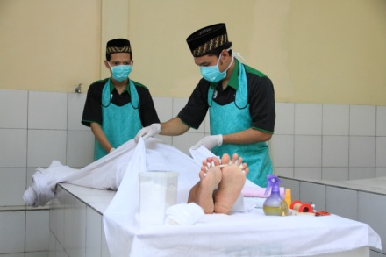
Ibadah Healthcare Services
SAKARATUL MAUT counseling
AL HUSNA jenazah handling service

Slide 38
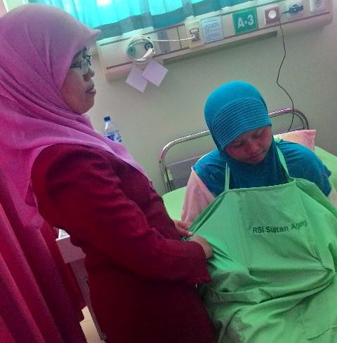
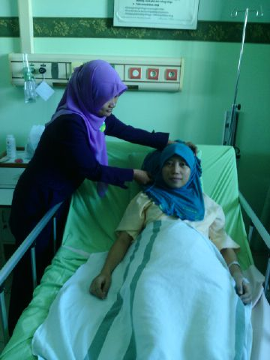
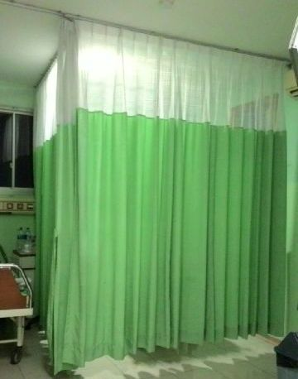
Hospital guarantees the effort to cover patient’s aurah (private parts), services according to like-gender and the prevention of ikhtilat (free mixing) element.
Cloth for Breastfeeding mothers
Hijab for female Patient
Privacy Curtains

Slide 39
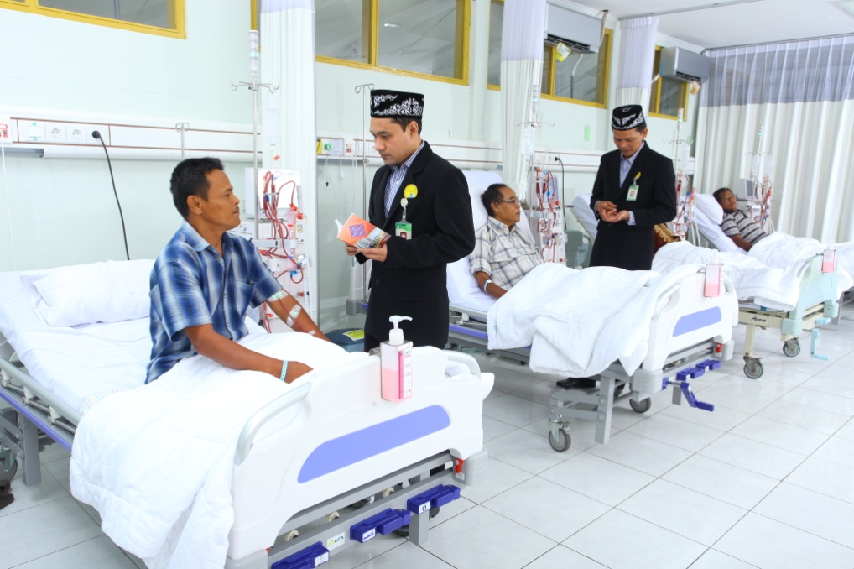
Spiritual Guidance by Special Request

Slide 40
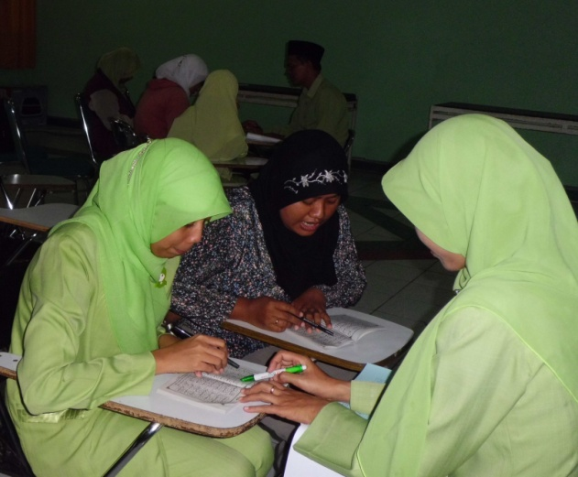
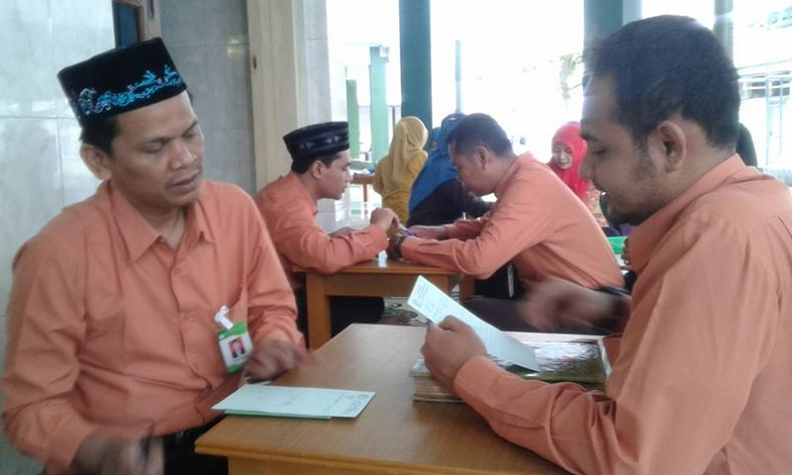
Mandatory Training for staff
Tahsin Tilawatil Qur’an / improvement of reading Quran

Slide 41
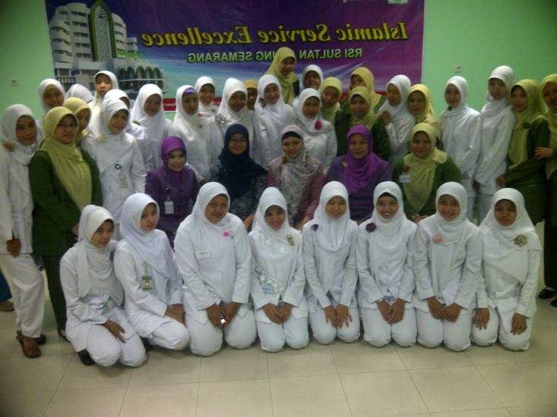
Mandatory Training for staff
Worship Training for Patient

Slide 42
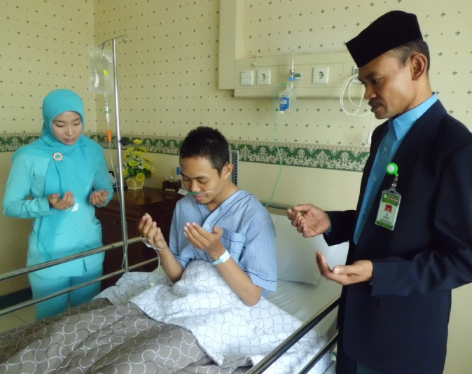
Praying before going to surgery room

Slide 43
NURSES HANDOVER NOTES

Slide 44
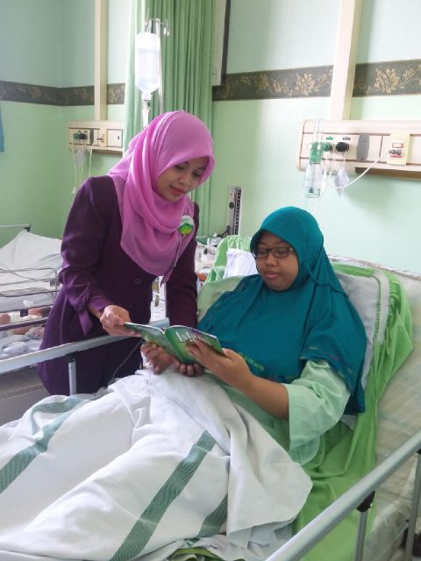
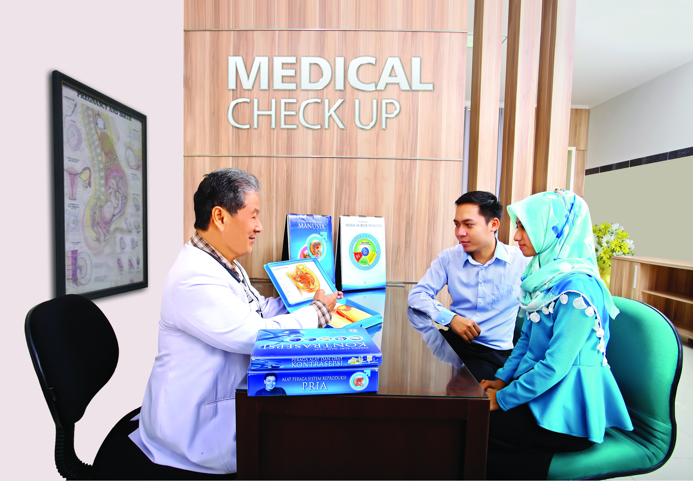
Education for Family Planning Programme
Fiqh Pregnancy Education

Slide 45
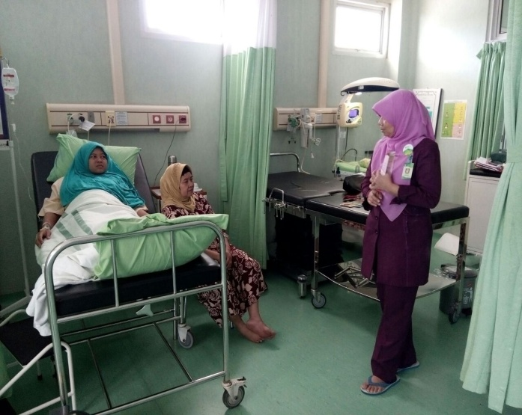
Fiqh breastfeeding Education
Fiqh Maternal Education in LR

Slide 46
MALAYSIA

Slide 47
Wet Ablution kit

Slide 48
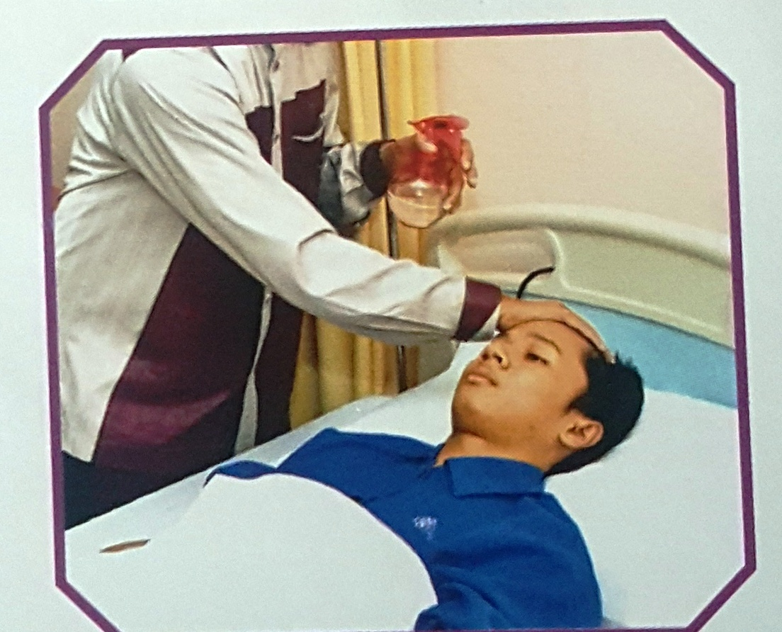
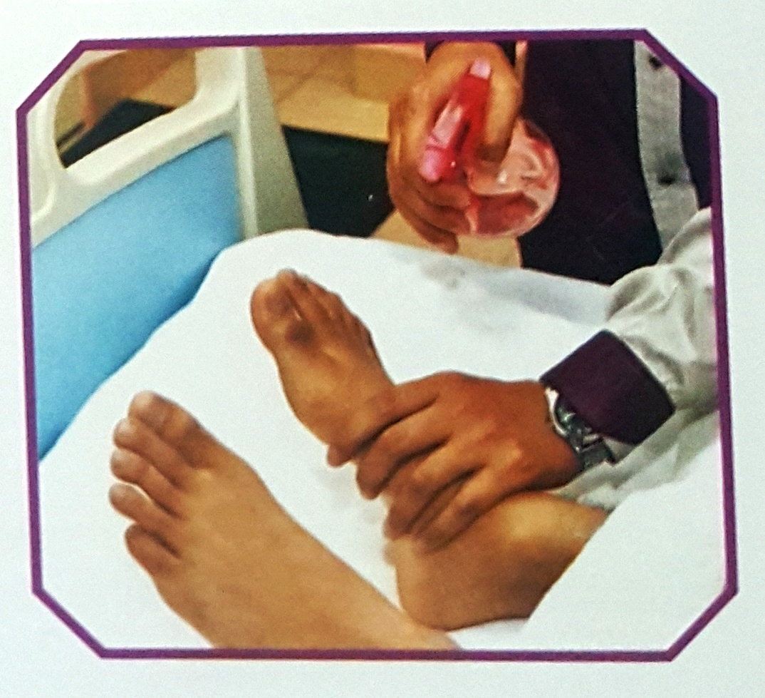
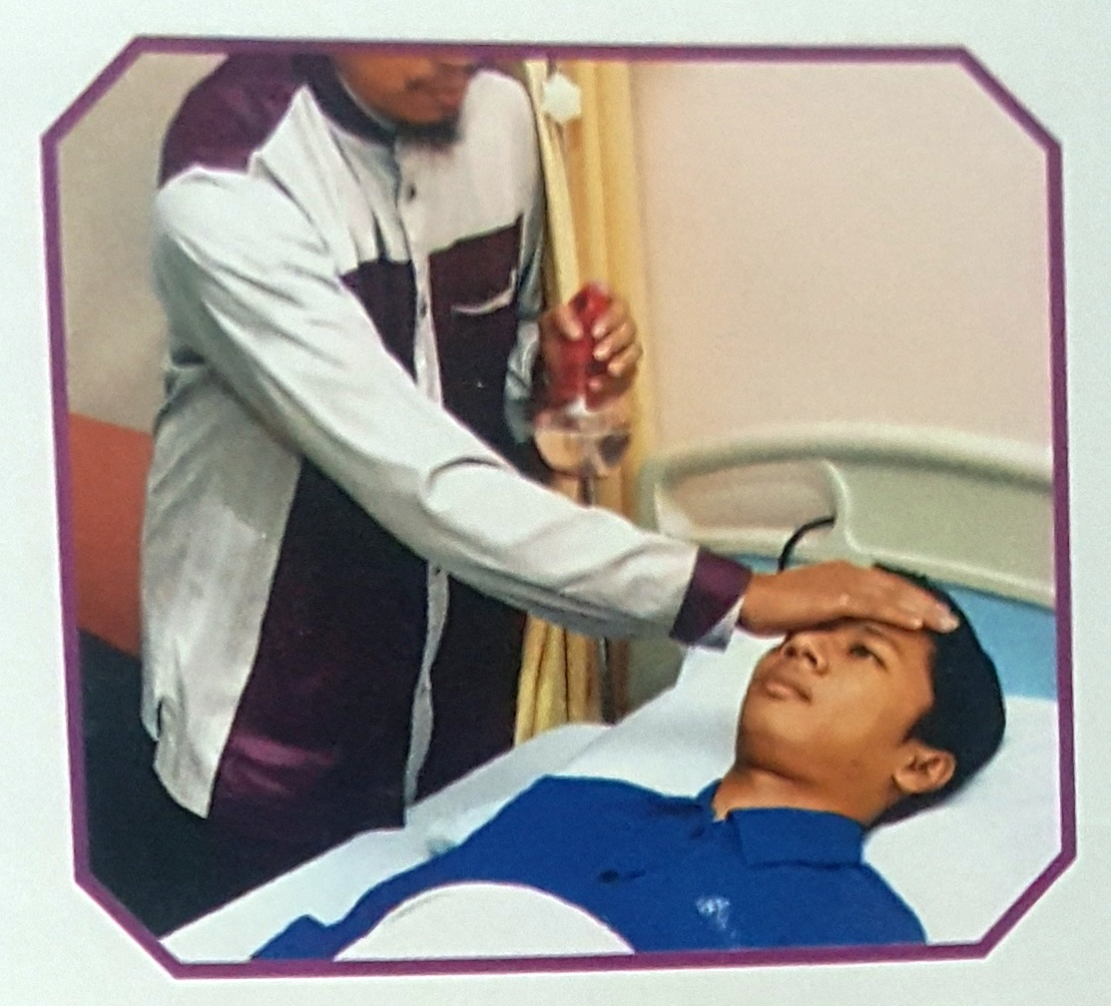
Assisting a patient to perform ablution

Slide 49
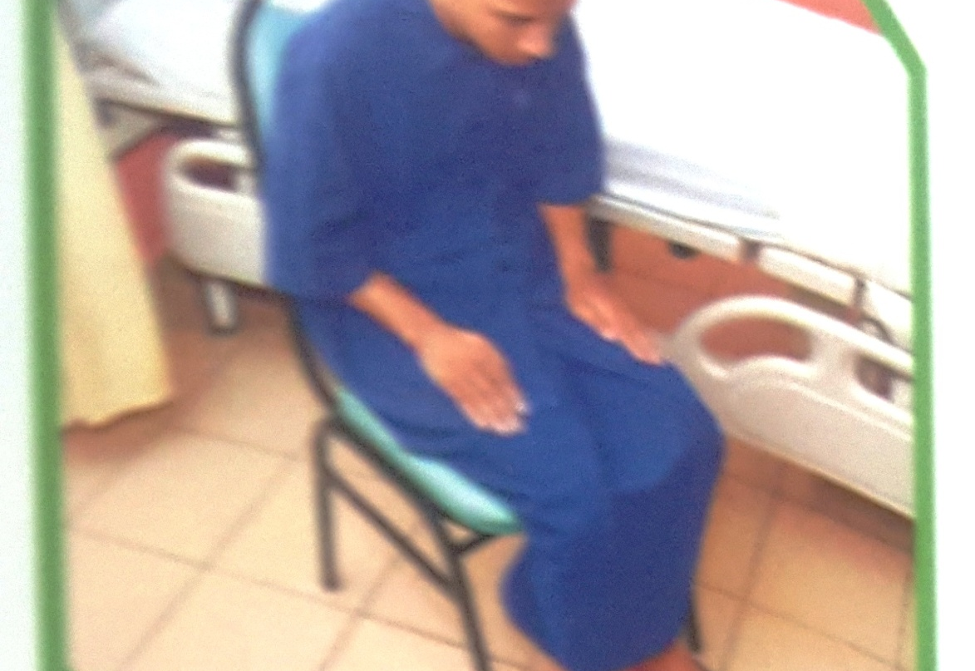
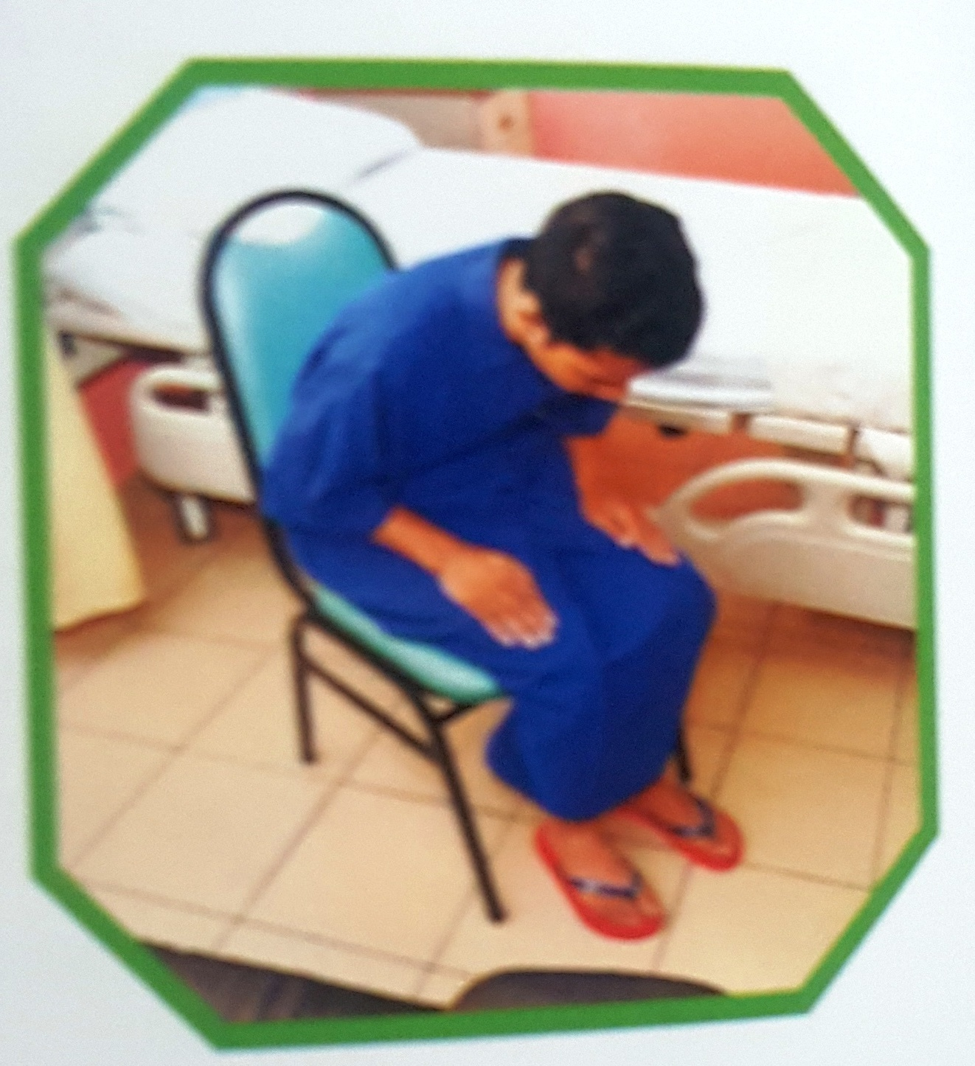
Performing salat while
sitting on a chair

Slide 50
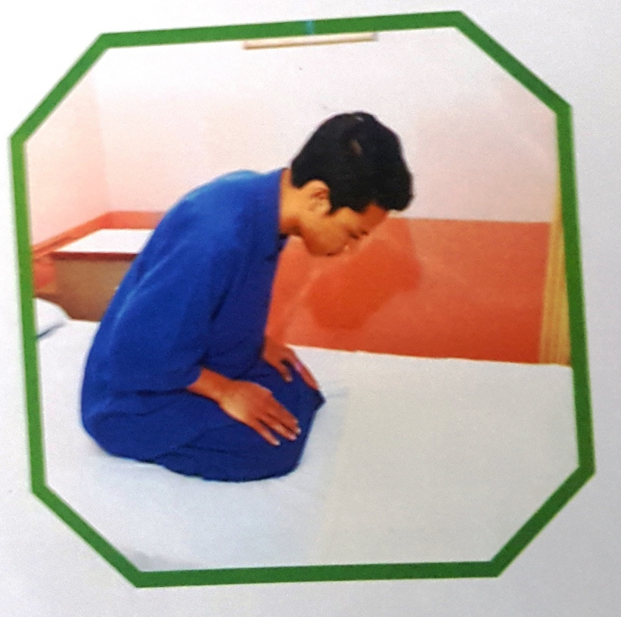
Performing Salat while sitting on the bed

Slide 51
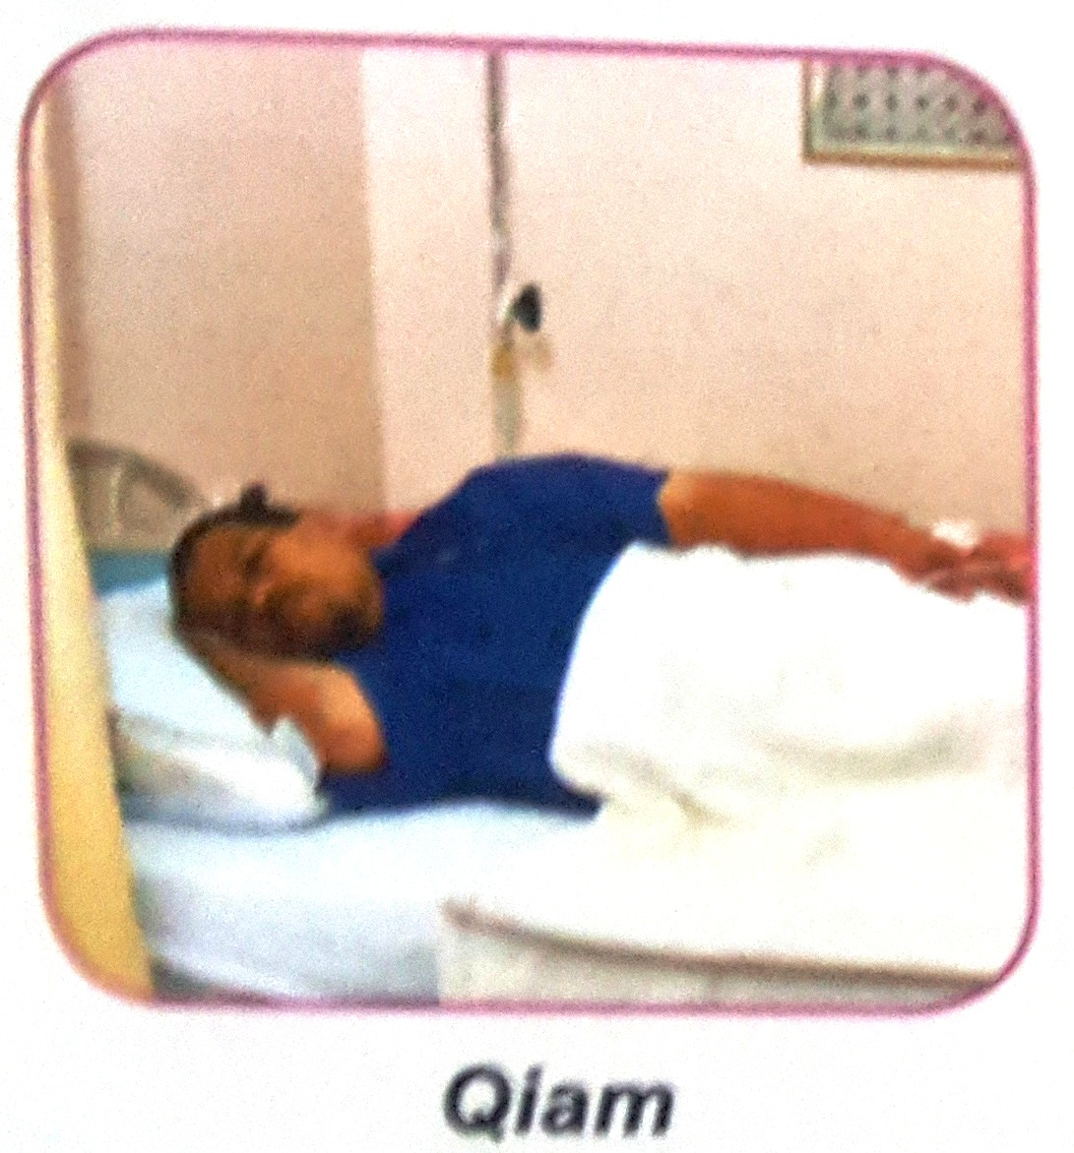
Performing Salat while lying on right side

Slide 52
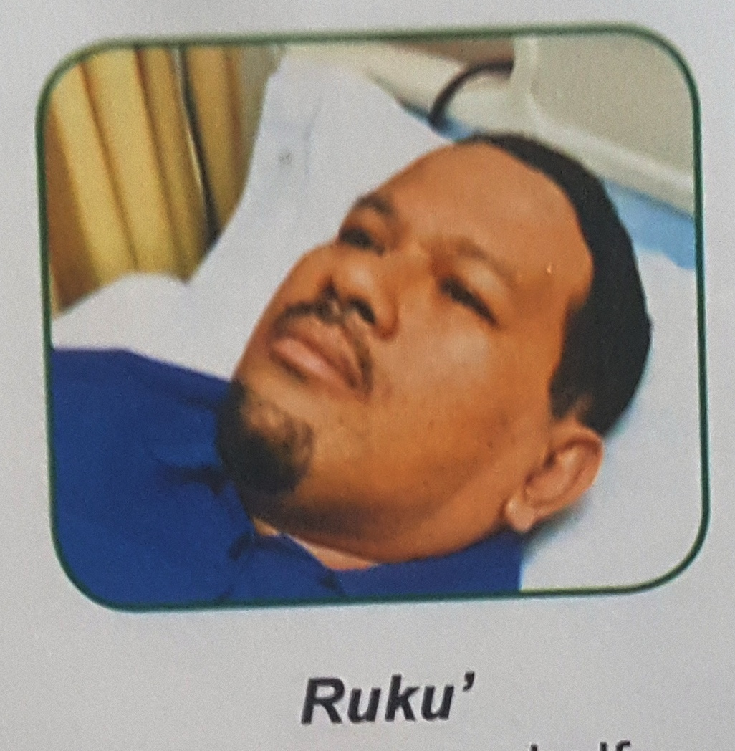
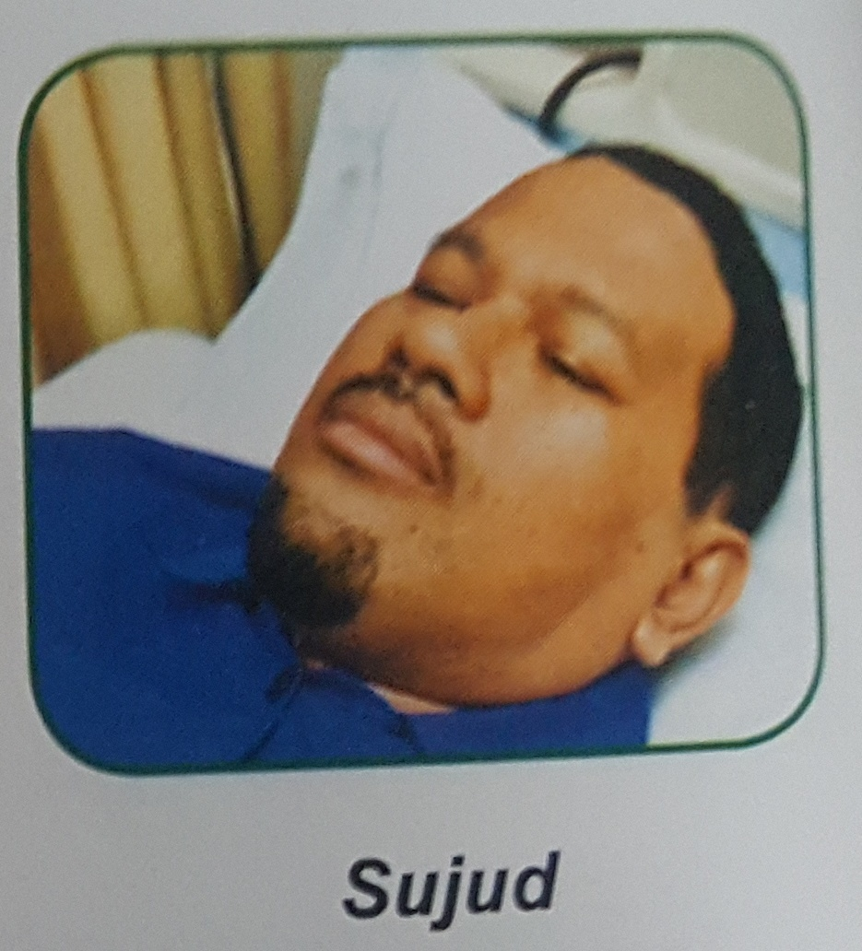
Performing Salat while lying on the
back

Slide 53
Prayer kit

Slide 54
Prayer kit

Slide 55
THE NIGERIAN EXPERIENCE

Slide 56
IFH – Nigerian Experience
Initial sensitization lecture during FIMA Conference in July, 2016 in Abuja Nigeria’
Muslim Health Facilities Consortium Committee (Ibadah Friendly Hospital concept is one of their TOR)
Followed by aggressive sensitization lectures that commenced in September 2018 in the following places states:
Sokoto, Kebbi, Kwara, Kano, Jigawa, Bauchi, Nasarawa, Plateau, Gombe, Katsina, Zamfara, Yobe and Borno.
Sensitization outside Nigeria
Tahoa and Maradi in Niger Republic

Slide 57
Nigerian experience
Implementation Team:
Sokoto – Reminder to perform prayers and considering patient’s spiritual wellbeing
Kebbi, Kaduna, Jigawa and Niger - Step down presentations
Maiduguri – Initiating Prayer Kit, and patient’s ziyarah team
Kano – Patient ablution and prayer assistance and guide
Zamfara state- FMC Gusau – Established Ibadah-Friendly Ward

Slide 58
Achievements recorded so far on the implementation of IFH in Nigeria.

Slide 59
School of Nursing Curriculum Development -1
GST 201 – INTRODUCTION TO ISLAMIC PERSPECTIVE IN NURSING.
History of Islamic Nursing
Significance of Nursing care in Islam
Ethical conduct of a Muslim Nurse
Qualities of a good Nurse in Islam
Nurse-Patient Relationship in Islam
Female Nurse in Islam
Hijab and Nursing in Islam

Slide 60
School of Nursing Curriculum Development -2
GST 202 - APPLICATION OF ISLAMIC PERSPECTIVES IN NURSING MANAGEMENT.
Care of patient in Islamic Nursing
Care of critically ill patient in Islam
Care of Dead patient(Last office) in Islam
Blood transfusion and other related procedures in Islam
Prayers and other obligations of patients in Islam and Nurse responsibility.

Slide 61
IMAN IBADAH FRIENDLY HOSPITAL PACK (PROTOTYPE)

Slide 62
Federal Medical Centre (FMC) Gusau-Report by a Nurse)
We located three places for praying and performing ablution.
We got donation from individuals of Qur’an, some books and mats for the place.
We usually gather patient’s relative every Tuesday for health talk and inform them about the praying for patient and the place demarcated.
We encourage staff to remind patients when it is time to pray.
We encourage patients to recite “ Kalimatush-Shahada” when dying and make them face the qiblah
We advice relatives to get handset to recite “Suratul Yasin” ( for dying patient but in a low volume ).
We do not involve non-Muslim patients.
We do not force Muslims that is not willing.

Slide 63
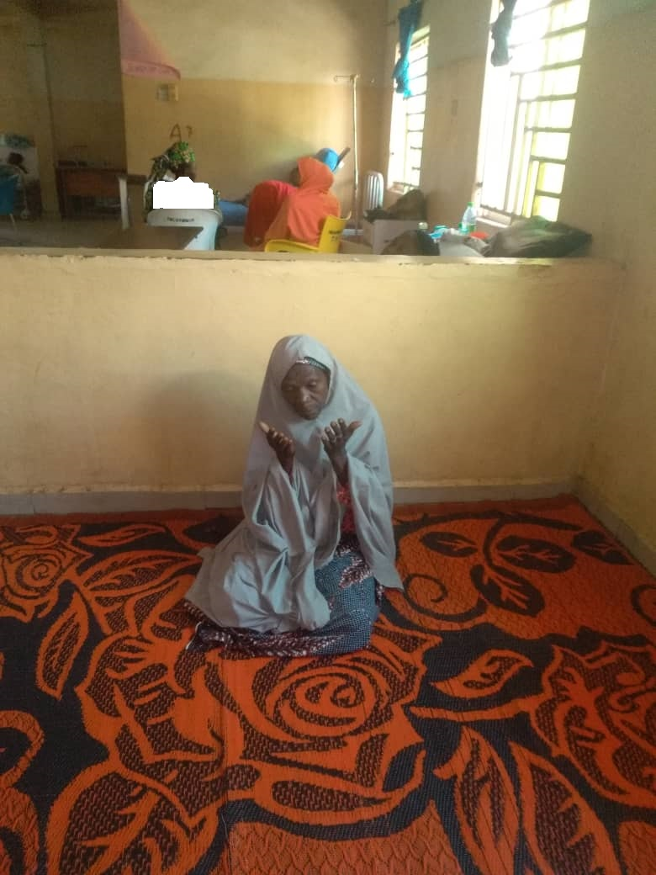
Ibadah-friendly ward at
Federal Medical Centre Gusau

Slide 64
IFH – Khalifa Sheikh Isyaka Rabiu Paediatrics hospital, Zoo road Kano- Report by a Nurse
After the presentation at AKTH on 24th October, 2019 which was the first time I heard about ibadah friendly hospital. I immediately did a step-down presentation to one doctor and the matron of SCBU.
We immediately decided with the matron to start implementation.
As such we decided to make hijabs available for mothers whose baby were admitted at SCBU.
After purchasing the hijab, we then showed the Medical Director (MD) and inform her about the concept which she welcomed 100%.
She then gave go ahead for the utilization as such they are currently using it at SCBU.

Slide 65
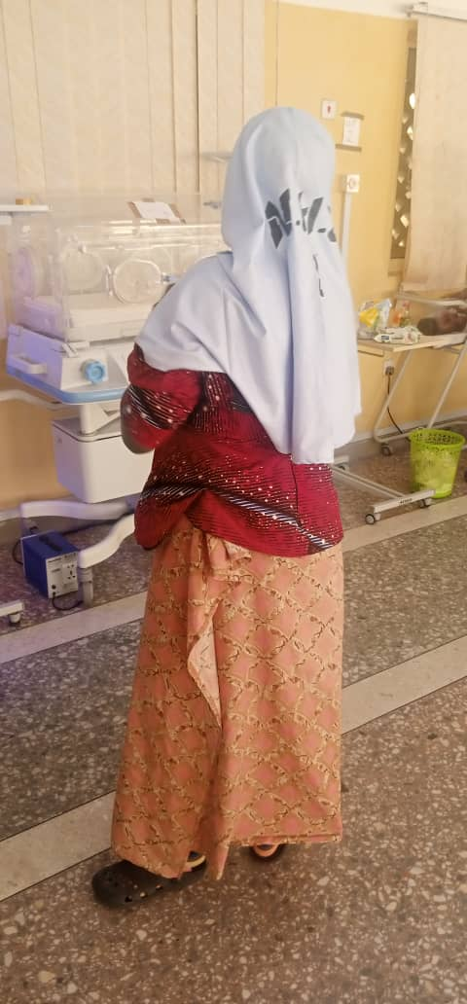
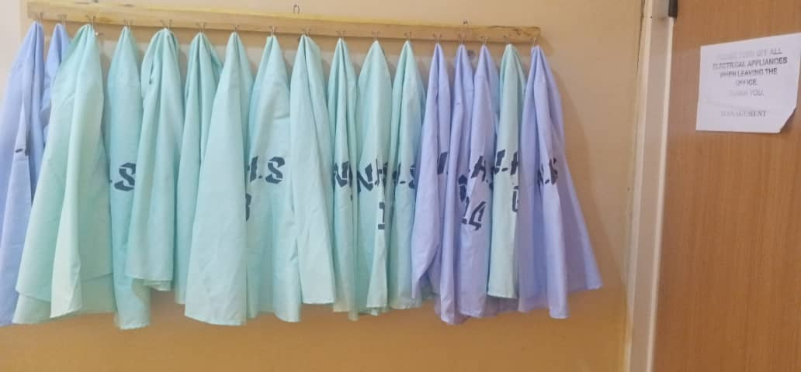
Production of Hijab for women to use at Special care baby unit (SCBU)

Slide 66
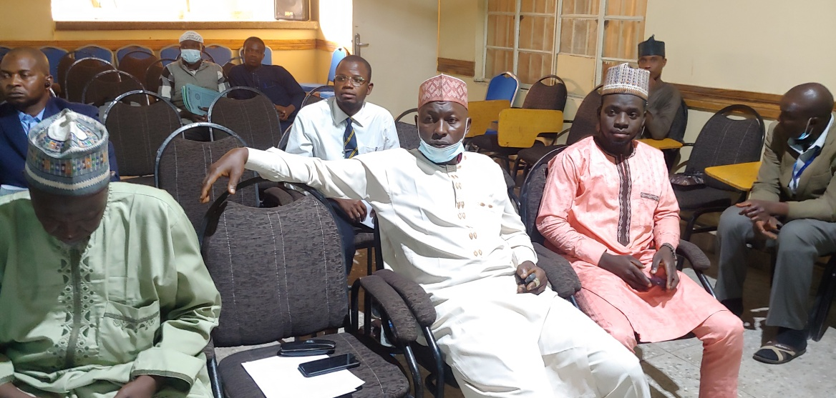
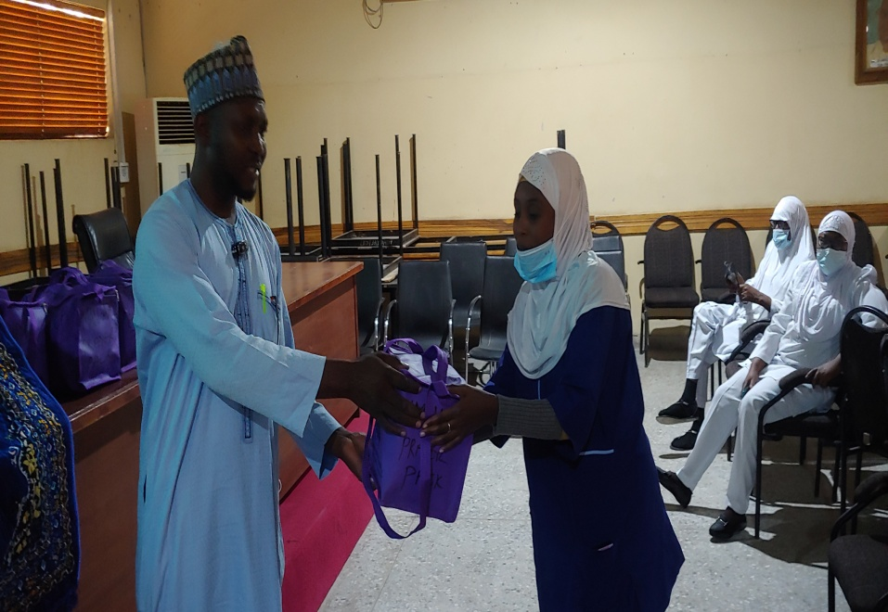
Training on IFH and distribution of prayer pack to IFH ward liaison’s officers at AKTH Kano

Slide 67
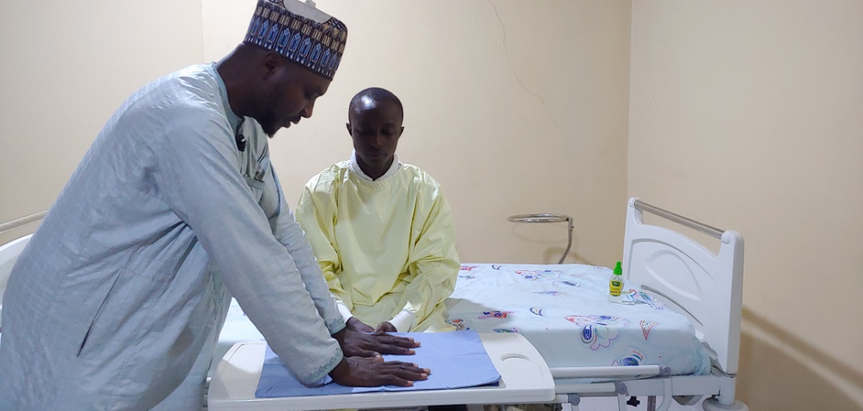
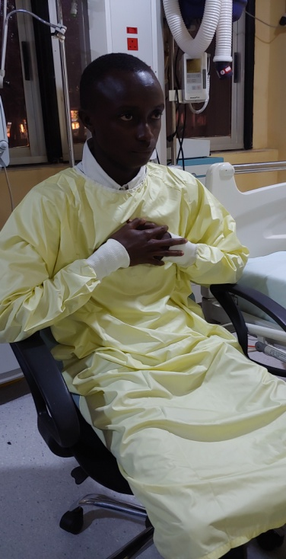
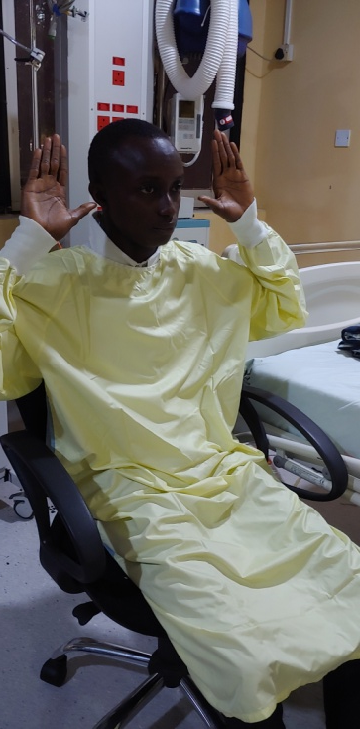
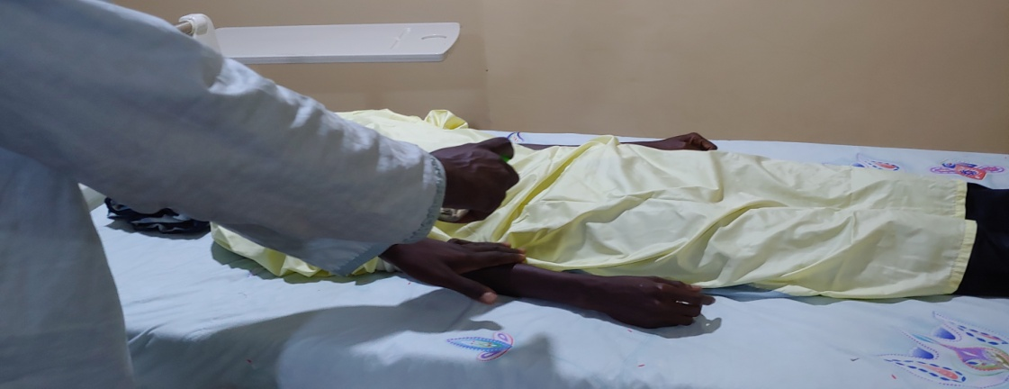
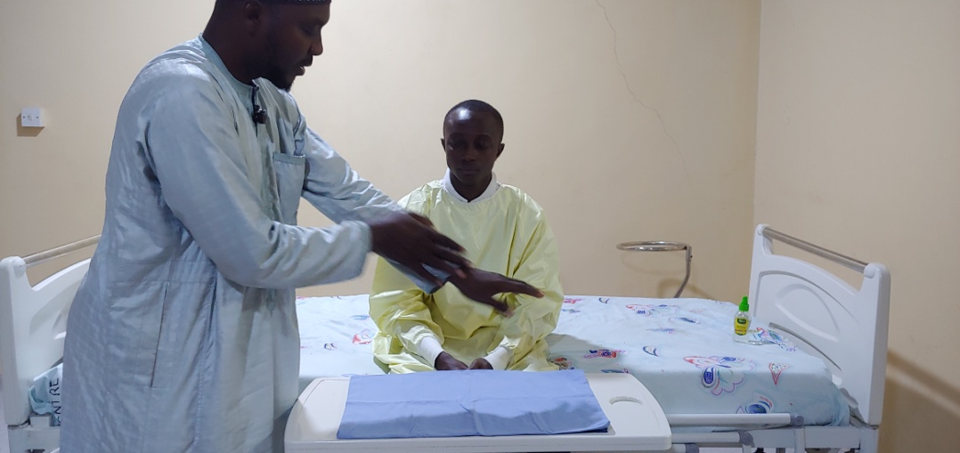
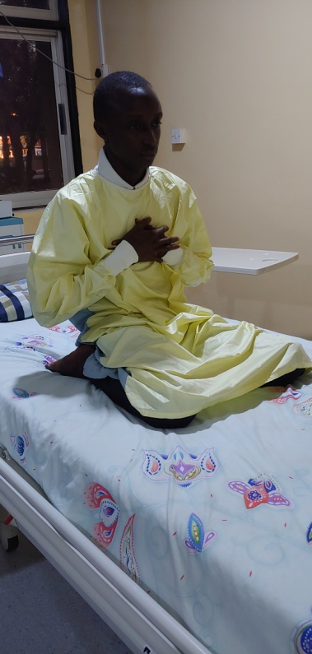
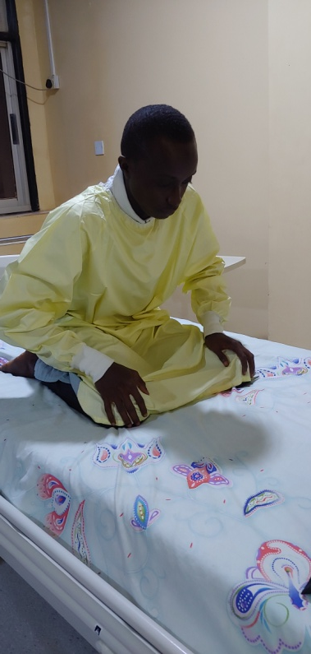
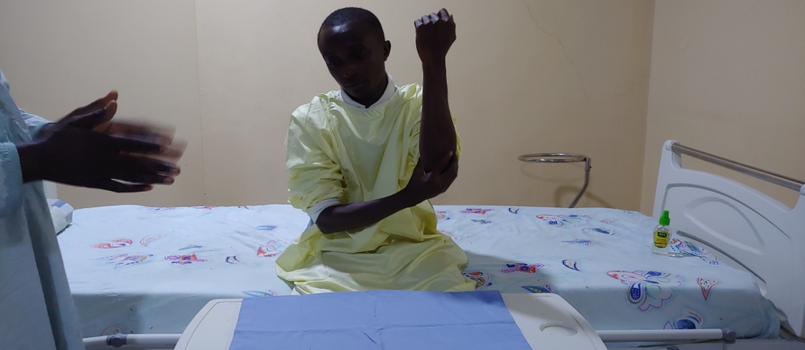
Demonstrating how to assist patient to perform Tayammum in Jigawa

Slide 68
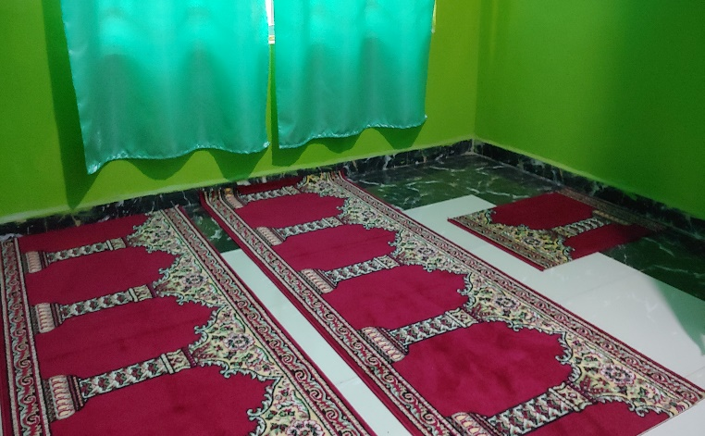
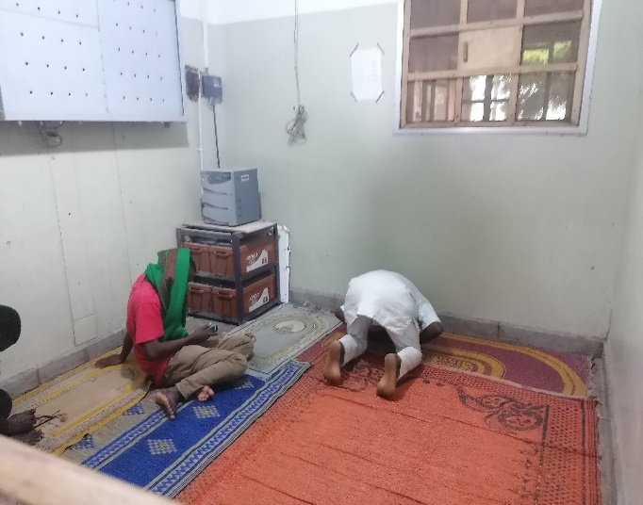
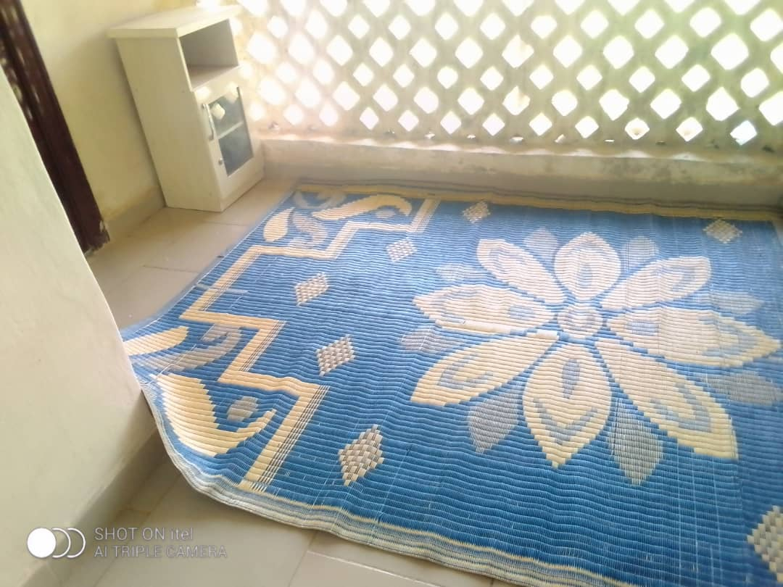
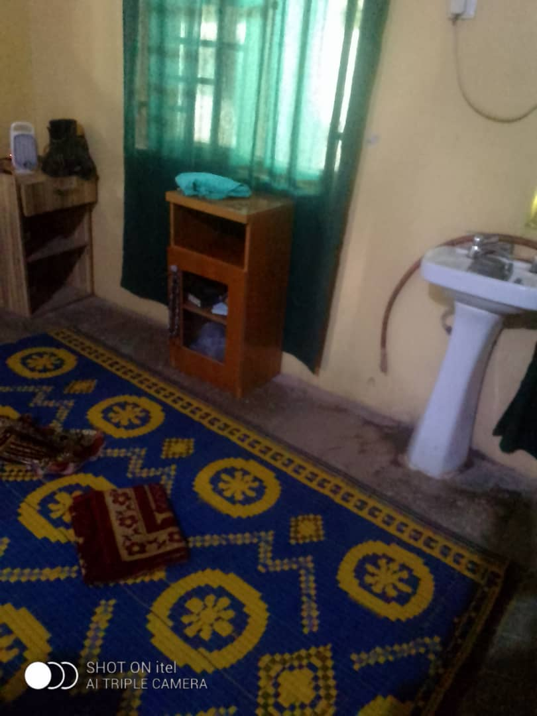
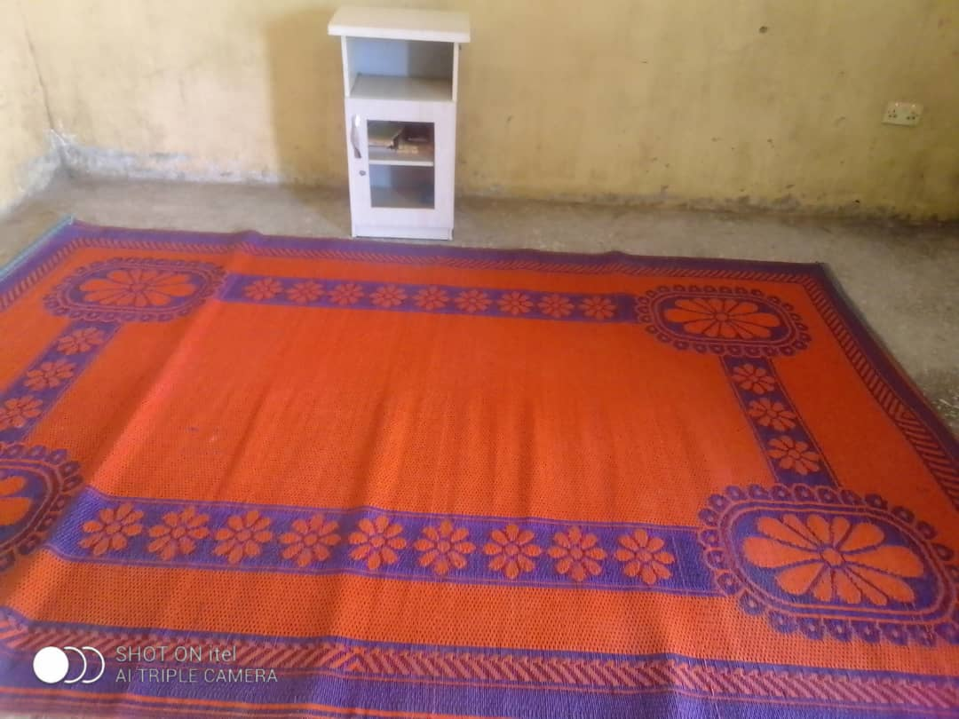
Establishment of various musallah (prayer room) for patients to be praying in the wards

Slide 69
Modification of Nurses uniform in some hospital and college of Nursing

Slide 70
Patient Ziyarah Team FTH Katsina

Slide 71
IFH practice – Patient with chest tube
PRAYING CUBICLE AT NEWLY ESTABLISHED FATIMA YAHAYA HOSPITAL, SIFAWA SOKOTO

Slide 72
Publications on IFH concept and practice by IMAN and IMAN Members

Slide 73
Publications on IFH concept and practice by IMAN and IMAN Members

Slide 74
How to Commence Ibadah Friendly Hospital Services
Establish an IFH team (State Chairman, Secretary, Da’awah Chairman, volunteers)
Step down presentation to an expanded state team
Advocacy to the respective management team for their support
Commencement routine patients visitation for spiritual care and guidance
Start small and focus on relevant issues in your environment
Regular evaluation programs
Staff evaluation ( Qu’ran recitation, fiqh,etc)
Patients’ evaluation
Patient’s relatives evaluation
Team members evaluation

Slide 75
Prayer position for sick person
Standing position
Resting on a stand
Sitting position
Lying on the right side facing Qiblah
Lying on the left side facing Qibla
Lying on the back with the leg facing Qiblah
Assuming any position
Praying with ablution
Praying with Tayammum
Praying without ablution or tayammum

Slide 76
Selected prayers for sick person
Prayers when feeling pain in the body
بِسْمِ اللَّهِ أَعُوذُ باللَّهِ وَقُدْرَتِهِ مِنْ شَرِّ مَا أَجِدُ وَأُحَاذِرُ
Bismillaah.'A'oothu billaahi wa qudratihi min sharri maa 'ajidu wa 'uhaathiru.
Put your hand on the place where you feel pain and say: "With the Name of Allah". (Three times) Then say: "I seek refuge in Allah and in His Power from the evil of what I find and of what I guard against". (Seven times)
Muslim 4/ 1728

Slide 77
Selected prayers for sick person – contd.
Prayers when closing the eyes of the dead.
اللَّهُمَّ اغْفِرْ لِفلَانٍ (باسمه) وَارْفَعْ دَرَجَتَهُ فِي الْمَهْدِيِّينَ، وَاخْلُفْهُ فِي عَقِبِهِ فِي الْغَابِرِينَ، وَاغْفِرْ لَنَا وَلَهُ يَارَبَّ الْعَالَمِينَ، وَافْسَحْ لَهُ فِي قَبْرِهِ وَنَوِّرْ لَهُ فِيهِ
Allaahummaghfir li-fulanin (name of the person) warfa' darajatahu fil-mahdiyyeena, wakhlufhu fee 'aqibihi fil-ghaabireena, waghfir-lanaa wa lahu yaa Rabbal-'aalameena, wafsah lahu fee qabrihi wa nawwir lahu feehi.
O Allah, forgive (say the person's name) and elevate his station among those who are guided. Send him along the path of those who came before, and forgive us and him, O Lord of the worlds. Enlarge for him his grave and shed light upon him in it.
Muslim 2/634

Slide 78
Selected prayers for sick person – contd.
When visiting the sick
لاَ بَأْسَ طَهُورٌ إِنْ شَاءَ اللَّهُ
Laa ba'sa tahoorun 'inshaa'Allaah.
Do not worry, it will be a purification (for you), Allah willing.
Al Bukhari.
أَسْأَلُ اللَّهَ الْعَظِيمَ، رَبَّ الْعَرْشِ الْعَظِيمِ أَنْ يَشْفِيَكَ
As'alullaahal-'Adheema Rabbal-'Arshil-'Adheemi 'an yashfiyaka.
I ask Almighty Allah, Lord of the Magnificent Throne, to make you well. (Seven times).
At- Tirmizi, Abu Dawud.

Slide 79
SUMMARY & CONCLUSION
Ibadah-Friendly Hospital concept is relatively new concept for the generality of Muslim Health workers in Nigeria.
Muslim need to turn back to the primary reason of their creation, i.e to worship Allah anywhere they are and to encourage others to do so.
Efforts has been put so far in sensitizing the Muslim ummah specifically Health workers in Nigeria about the IFH concept and practice in the last seven years which has done a lot in re-orienting the Muslim Health workers.
Several efforts are now been made by Muslim Health workers towards implementing the Ibadah-Friendly care in their various hospitals.
The AKTH IFH services is likely to serve as the model of IFH in Nigeria and in sha Allah.
More effort and collaborations as well as advocacy are needed to promote the understanding and implementation of the IFH services in Nigeria.

Slide 80
SUMMARY & CONCLUSION
The IFH concept has been a major milestone in the process of Islamisation in medical service delivery.
This concept allows Muslim health workers the flexibility to be a d’aee at all the times.
Muslim Health workers while performing their normal duties are also gaining rewards (ibadah) if they have the proper niyah (intention).

Slide 81
REFERENCES
Mas’ud I, AbdHalim S, Shafi SM, Ramli NAA, Awang MZ, Subhan IA. . What is a Ibadah Friendly Hospital. Journal of British Islamic Medical Association. Islam & Health. Vol 7no 3. April 2021. www.jbima.com.
Salisu Ismail. Ibadah-Friendly hospital: concept and practice. Dutse: Maje Arts and General Printing; 2020.
Translation of Holy Qur’an by Ibn Katheer 51:56.
Hospital Pakar Al-Islam. Outline: ibadah-friendly hospitals. Malaysia: 165 Print Solutions Sdn. Bhd; 2016.
Salisu Isma’il, Abdulwahab Murtala Akibu, Rabiu Abdullahi, Usman Muhammad Alfa, Ummukulsum Abdurrazak. Are Muslim patients praying consistently while on hospital admission? Abstracts presented during annual general meeting and scientific conference of the Islamic Medical association of Nigeria (IMAN), 9th – 12th September, 2021.
Compilation of Prophetic Ahadith by Imam An-Nawawi.
Hafeez Ur Rahman, Aly Mishal, Najib Ul Haq, Ishak Mas`ud. Muhammad Irfan. Islamic Hospital Guidelines. Pakistan: Peshawar Medical College, Prime foundation & Pakistan Islamic Medical Association; 2017, P 19. ISBN: 978-969-7817-00-9.
Compilation of Prophetic Ahadith by Imam Bukhari.

Slide 82
REFERENCES
8. Compilation of Prophetic Ahadith by Imam Ahmad.
Salisu isma’il. Conduct of health care workers: a public concern, a
paper presented during annual general meeting and scientific conference of
Islamic Medical Association (IMAN) Federal Medical Centre
Birnin Kebbi branch, 31st October, 2021.
10. Compilation of Prophetic Ahadith by Imam Muslim.
11. Compilation of Prophetic Ahadith by Imam Tirmithi.
12. Compilation of Prophetic Ahadith by Imam Abu Daud.
13. Patient Ibadah Leaflet by Aminu Kano Teaching Hospital IMAN Sisters Forum.

Slide 83
THANK YOU FOR YOUR ATTENTION, ASSALAMU ALAIKUM WA RAHMATULLAHI WA BARAKATUHU

