Slide 1

ISLAMIC MEDICAL ASSOCIATION OF NIGERIA (IMA-NIGERIA)/
FEDERATION OF ISLAMIC MEDICAL ASSOCIATION (FIMA)
SAVE DIGNITY PROJECT REPORT
DR. IB SULE
DR. H.UMAR SULAYMAN
DR.S.ISMAIL
MAT. N. BALARABE
PRESENTED TO JAIZ CHARITY AND DEVELOPMENT FOUNDATION
14TH SHAWWAL 1439AH/28TH JUN 2018

Slide 2

OUTLINE
INTRODUCTION
WHAT IS OBSTETRIC FISTULA/ MEDICO-SOCIAL IMPLICATIONS
FIMA SAVE DIGNITY PROJECT
VVF CAMPS
CONCLUSION
COMMENDATION/GRATITUDE
UPCOMING ACTIVITIES/PROJECTS

Slide 3
INTRODUCTION

Slide 4
IMA-NIGERIA
Formed in Makkah, Saudi Arabia in 1989.
Registered with Corporate Affairs Commission(CAC) of Nigeria 23 years ago with registration no. RC 7926.
It serves as an umbrella body for all Muslim Health Professionals in Nigeria.
Has established branches in 25 states of Nigeria including Federal Capital Territory(FCT) Abuja.
Full affiliation with FIMA in 2012.

Slide 5
WHAT IS OBSTETRIC FISTULA/ MEDICO-SOCIAL IMPLICATIONS

Slide 6
DEFINITION OF VVF
Vesico-Vaginal Fistula (VVF) is defined as an abnormal connection between the bladder and the vagina.
It is usually caused by prolonged obstructed labour.
The baby’s head compresses the bladder between the (hip) pelvic bone and the vagina.

Slide 7
DEFINITION OF VVF
This leads to decreased blood supply to that area, death of the tissue and sloughing leading to a hole in the bladder connecting it to the vagina.
This abnormal connection leads to continuous leakage of urine from the bladder to the vagina or leakage of feaces.
The treatment of this condition is usually surgery.

Slide 8
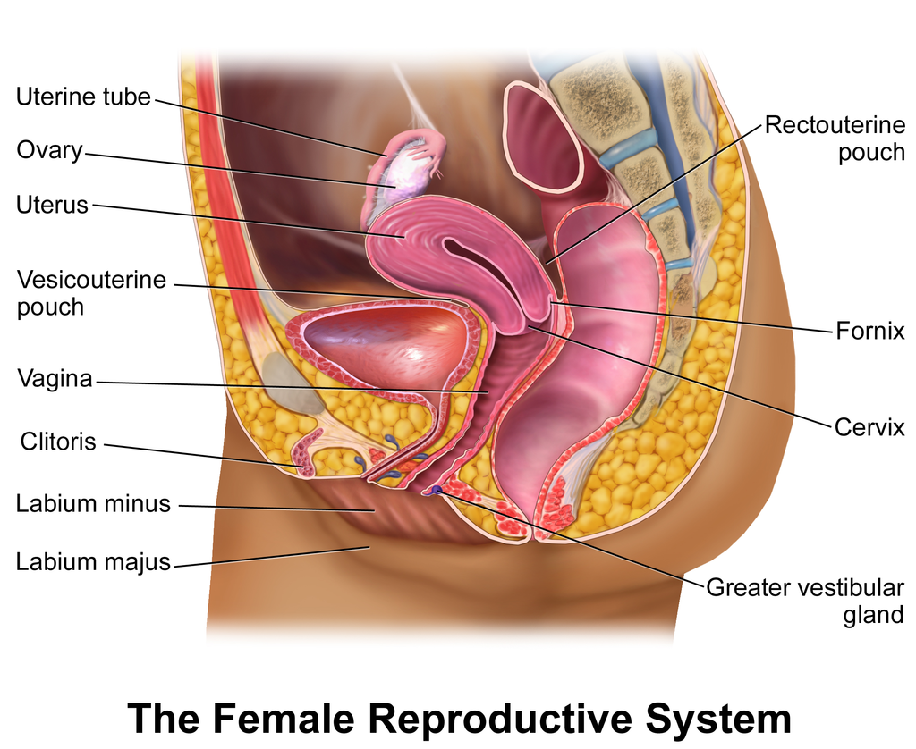
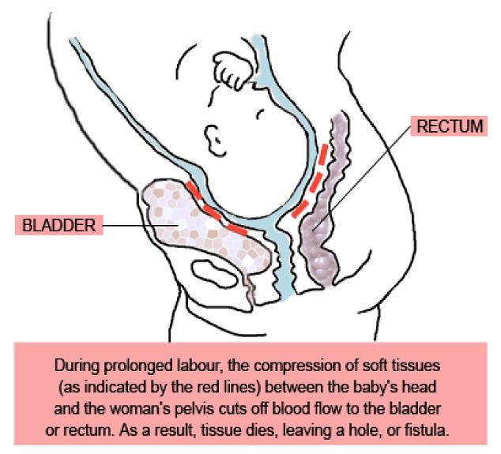

Slide 9
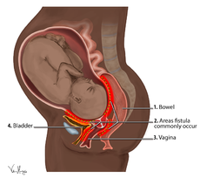
Notes:
Sun should not set twice on a woman in labour.

Slide 10
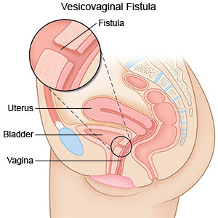

Slide 11
PREDISPOSING FACTORS TO OBSTETRIC FISTULA
Early Marriage, Pregnancy & Childbirth
Illiteracy And Ignorance
Poverty
Poor Health-seeking Behaviour
Delays In Using Health Facility
Delays In Reaching Health Facility
Poor Health Infrastructure (For Caesarean Delivery When Needed)

Slide 12
WHY WOMEN DIE/HAVE MORBIDITIES IN PREGNANCY & CHILDBIRTH: THE THREE DELAYS
2nd Delay
Delay in Accessing the Health Facility
3rd Delay
Delay in receiving care at the health facility
1st Delay
Delay in the Home
Notes:
Sun should not set twice on a woman in labour

Slide 13
PREVALENCE
2 million women globally
50,000-100,000 new cases each year
40% in Nigeria
60% in other countries:
  Ethiopia
  Somalia
  Niger
  Chad
  Sierra Leon
  Ghana
  Bangladesh
  India
  etc

Slide 14
DISTRIBUTION OF FISTULAE IN NIGERIA: LATE 1990’s
NW.
NE
NC
Higher than average
SW
SS
SE
National average
Less than national average
National Foundation on VVF Estimation

Slide 15
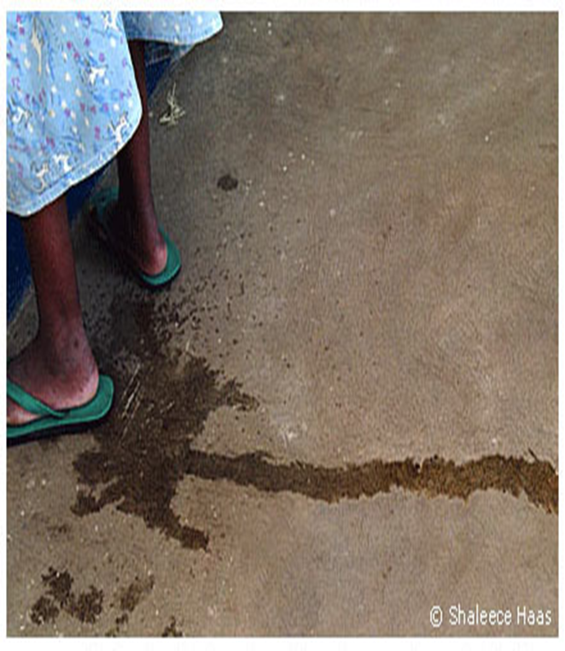

CLINICAL FEATURES OF VVF
Leaks urine (or faeces) always and is wet, dirty and smelling.
Vulval excoriations
Urinary & genital tract infections
Secondary amenorrhea
Obstetric palsy (foot-drop)
Pressure ulcers on buttocks
Infertility
Depression

Slide 16
SOCIAL PREDICAMENT
Feels inadequate, loses self confidence and avoids people
Abandoned by her husband, her family and her own community.
Becomes a destitute
Some resort to prostitution for survival
MOSTLY MUSLIM WOMEN OF LOW SOCIO-ECONOMIC STATUS FROM NORTHERN NIGERIA

Slide 17
FIMA SAVE DIGNITY PROJECT

Slide 18
FIMA PROJECTS
SAVE VISION
SAVE SMILE
SAVE DIGNITY
FIMA RELIEF
Save Dignity Project: was formed because VVF affects poor people from developing countries of the world.
FIMA organizes VVF repair camps to help the victims to regain their dignity.
IMA- Nigeria organized one of such camps.

Slide 19
VVF CAMPS

Slide 20
ORGANIZATION OF VVF CAMP
COLLABORATIONS
The JAIZ Charity and Development Foundation
The Wife of the Governor of Niger State, Dr. Amina Abubakar Sani Bello through her NGO called RAiSE Foundation
Engender Health (Fistula Care).
Society of Obstetrics & Gynaecology of Nigeria. (SOGON)
Niger and Sokoto State Governments.

Slide 21
ORGANIZATION OF VVF CAMP
IMA- Nigeria championed the organization of the VVF camps as follows:
Clients recruited via media –radio, TV, VVF client network, word of mouth, etc.
Hospitals for repairs were chosen based on being designated centres for VVF repairs or willingness of the hospital to participate.
Government hospitals in Niger and Sokoto States were used for the camps.

Slide 22
ORGANIZATION OF VVF CAMP
Fistula Surgeons were FIGO certified and provided by NGOs like Engender Health under their Fistula Care Nigeria program and Society of Gynaecology & Obstetrics of Nigeria (SOGON)
They provided logistics like honorarium, accommodation, feeding and transportation, provision of consumables for the surgery and diesel for the generator during surgeries.

Slide 23
ORGANIZATION OF VVF CAMP
IMA-Nigeria:
Fed the patients and their relatives during the period of the surgery and the post-operative hospital stay (3 weeks).
Transportation of patients and relatives to and from the hospitals.
Provided pre and post-operative drugs and consumables.
Honorarium, accommodation, feeding of fistula surgeons on some occasions.
Transportation, accommodation and feeding of the Save Dignity members
Any other things needed for the patients to have successful surgeries including blood transfusion, etc.

Slide 24
ORGANIZATION OF VVF CAMP
CAMPS
Vesico Vaginal Fistula (VVF) repair camp were held in July 2016 at Sabon Wuse hospital, in Niger State of Nigeria as part of the pre-conference activities of the IMAN-FIMA International conference which held in Abuja, the Nigeria capital.
Three other camps were held at the Maryam Abacha VVF hospital in Sokoto, Sokoto state in December 2016, February, May and November 2017.

Slide 25
ORGANIZATION OF VVF CAMP
RESOURCES
JAIZ Charity and Development Foundation donated the sum of five million naira only (N5, 000, 000.00) ($14,285.7) to IMAN for the repair of one hundred patients.
The Wife of the Governor of Niger State, Dr. Amina Abubakar Sani Bello also donated the sum of one million naira only (n1, 000, 000.00) ($2857.1).
Total cost: N6,000,000.00 ($17,142.8).

Slide 26
ORGANIZATION OF VVF CAMP
RESULTS:
Total No. of Patients = 117
Dry after repair = 87
Cure rate = 74.4%
Those that were still wet were 30 which is 25.6%.

Slide 27
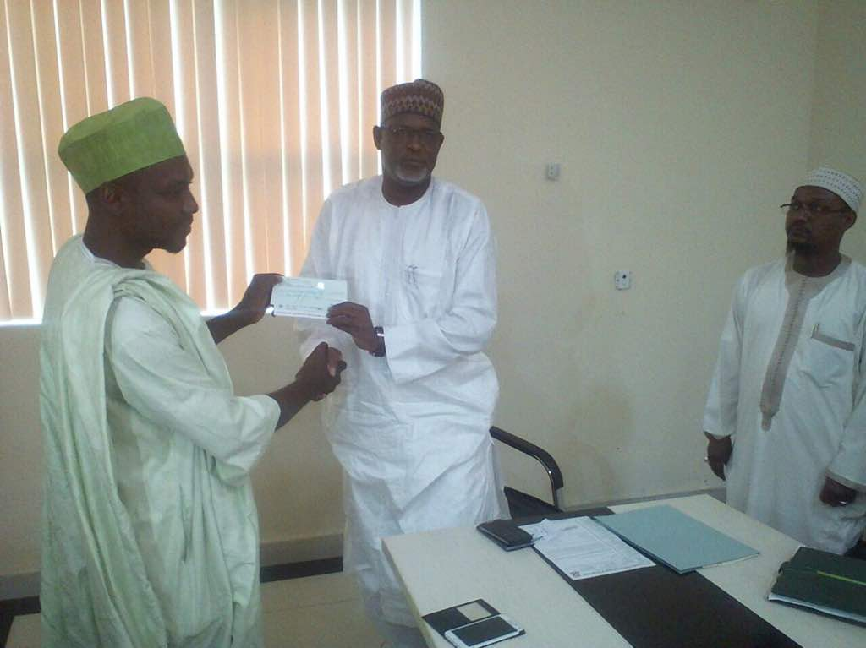
      PHOTO SPEAKS
      Donation By Jaiz Charity and development Foundation

Slide 28
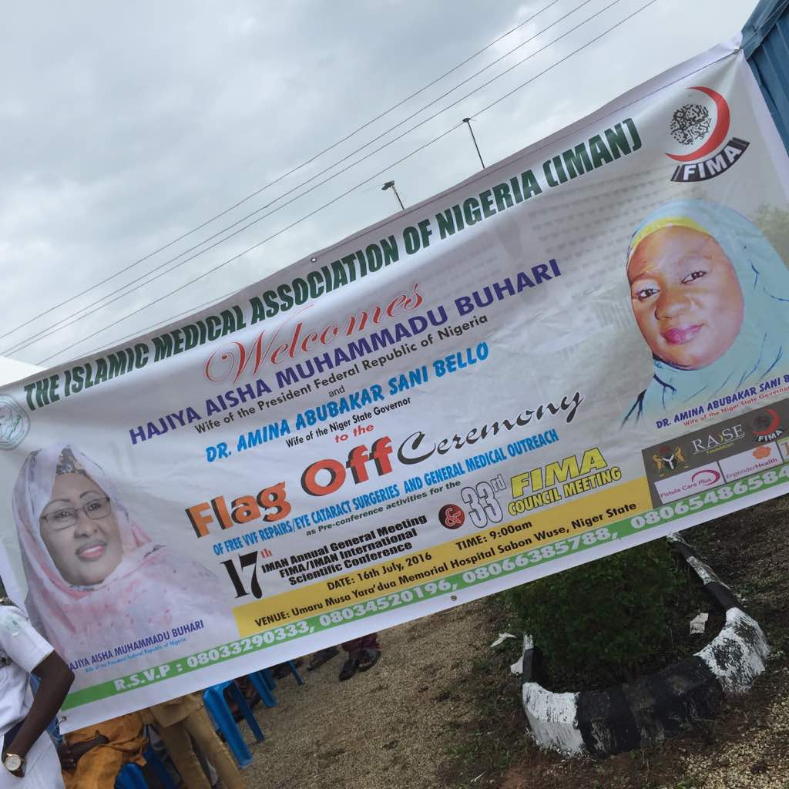
      Sabon Wuse Camp

Slide 29
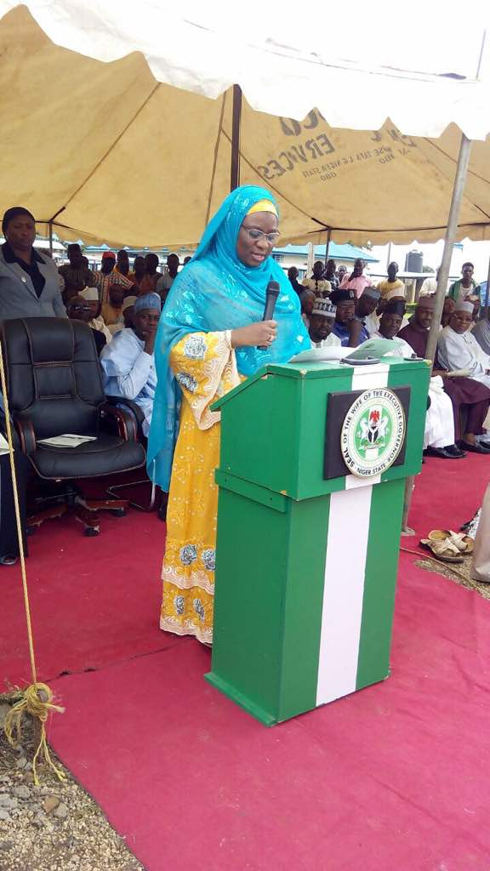
      The Wife of the Governor of Niger State during the FIMA Conference

Slide 30
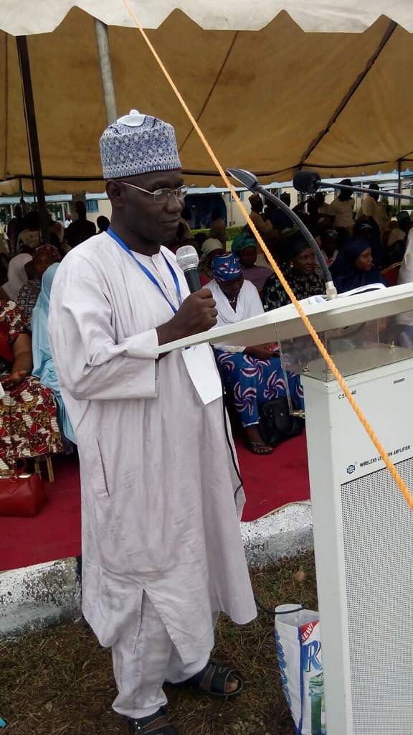
      Dr. IB Sule, the Head of the FIMA Save Dignity Committee during the FIMA Conference

Slide 31
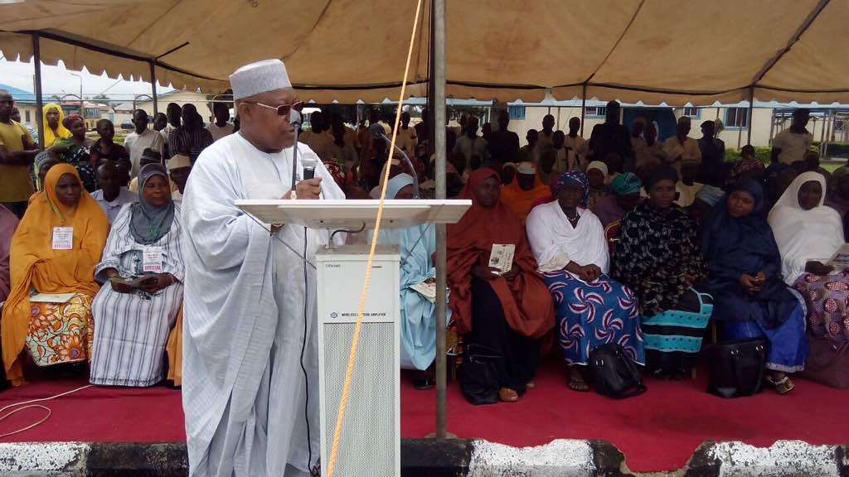
      Alhaji Muttalab, giving his goodwill message at the FIMA Conference

Slide 32
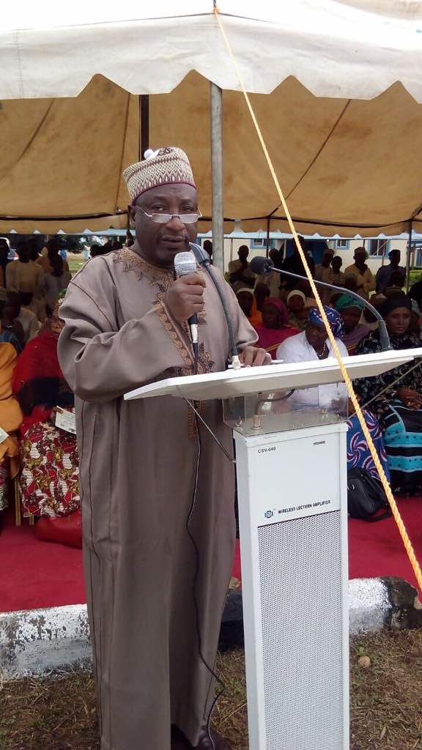
      Dr. Habib Sadauki the Head of Engender Health giving his goodwill message during the FIMA Conference

Slide 33
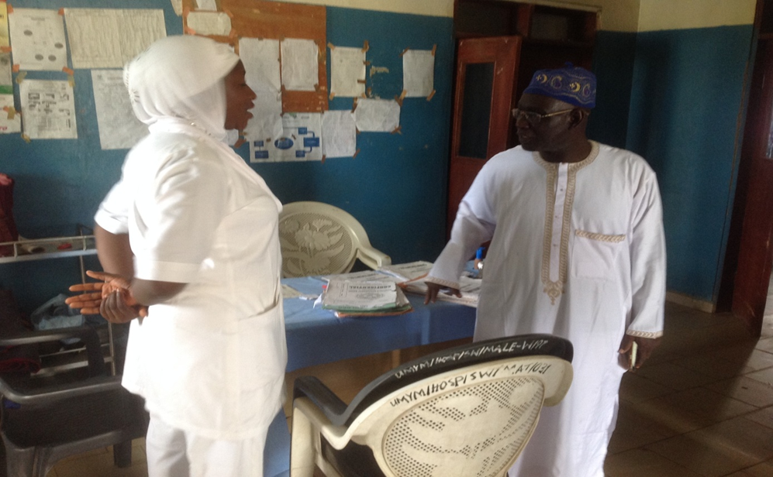
DR SULE WITH NURSING STAFF AT SABON WUSE HOSPITAL

Slide 34
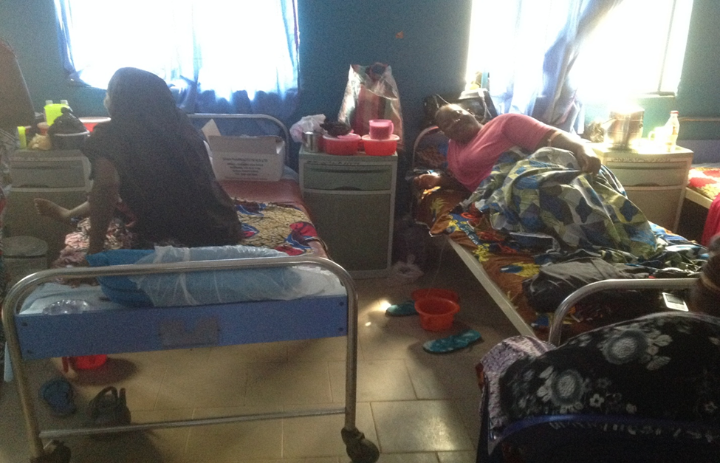
POST OPERATIVE RECOVERY, SABON WUSE HOSPITAL

Slide 35
      POST OPERATIVE RECOVERY, SABON WUSE HOSPITAL

Slide 36
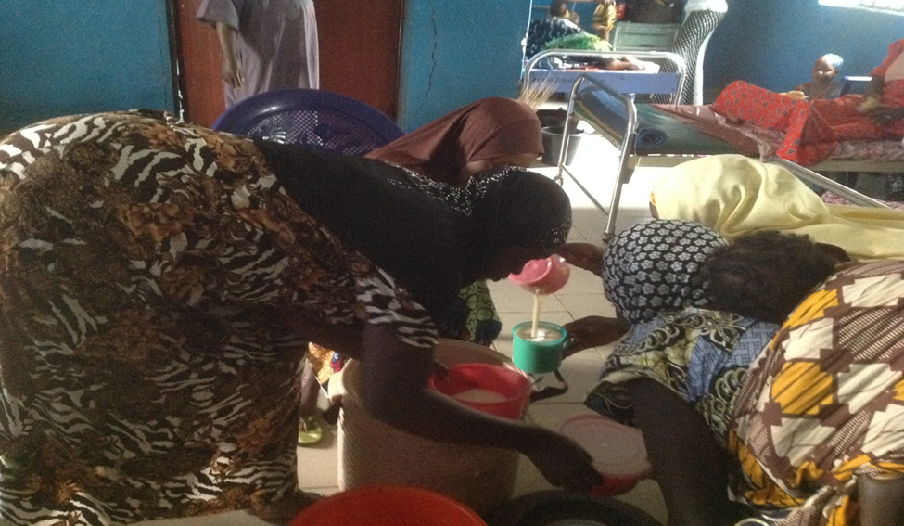
FEEDING OF PATIENTS BY IMA-NIGERIA MEMBERS, SABON WUSE

Slide 37
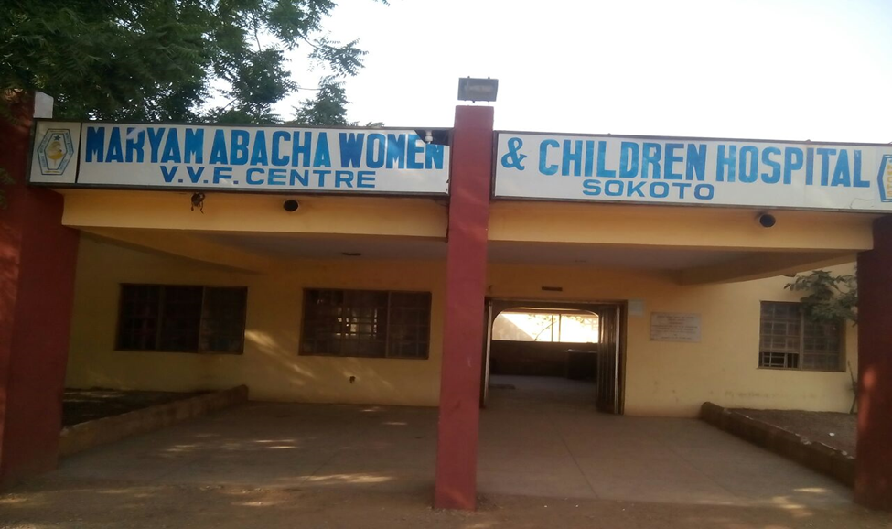

Slide 38
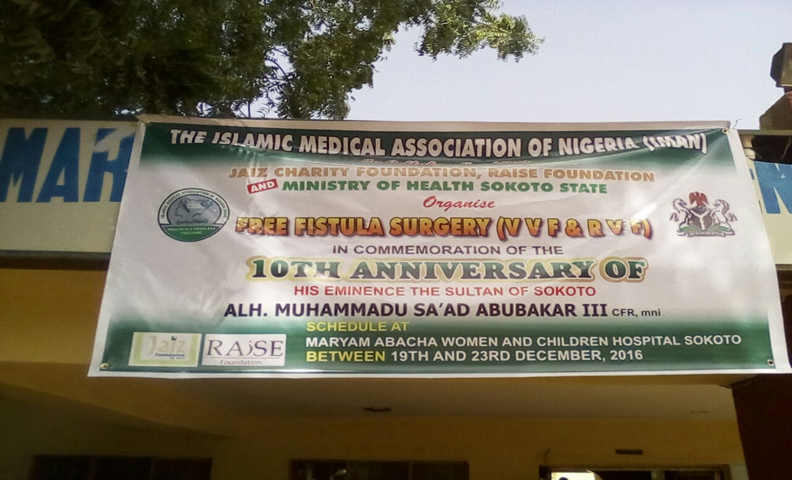
IMA-NIGERIA FREE VVF SURGERY BANNER

Slide 39
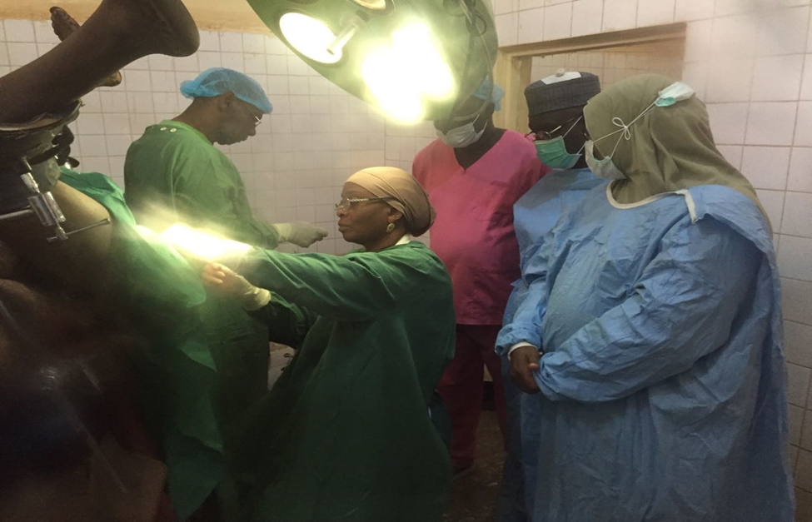
DR M. HASSAN AND SOME IMA-NIGERIA MEMBERS IN THE THEATRE IN SOKOTO

Slide 40
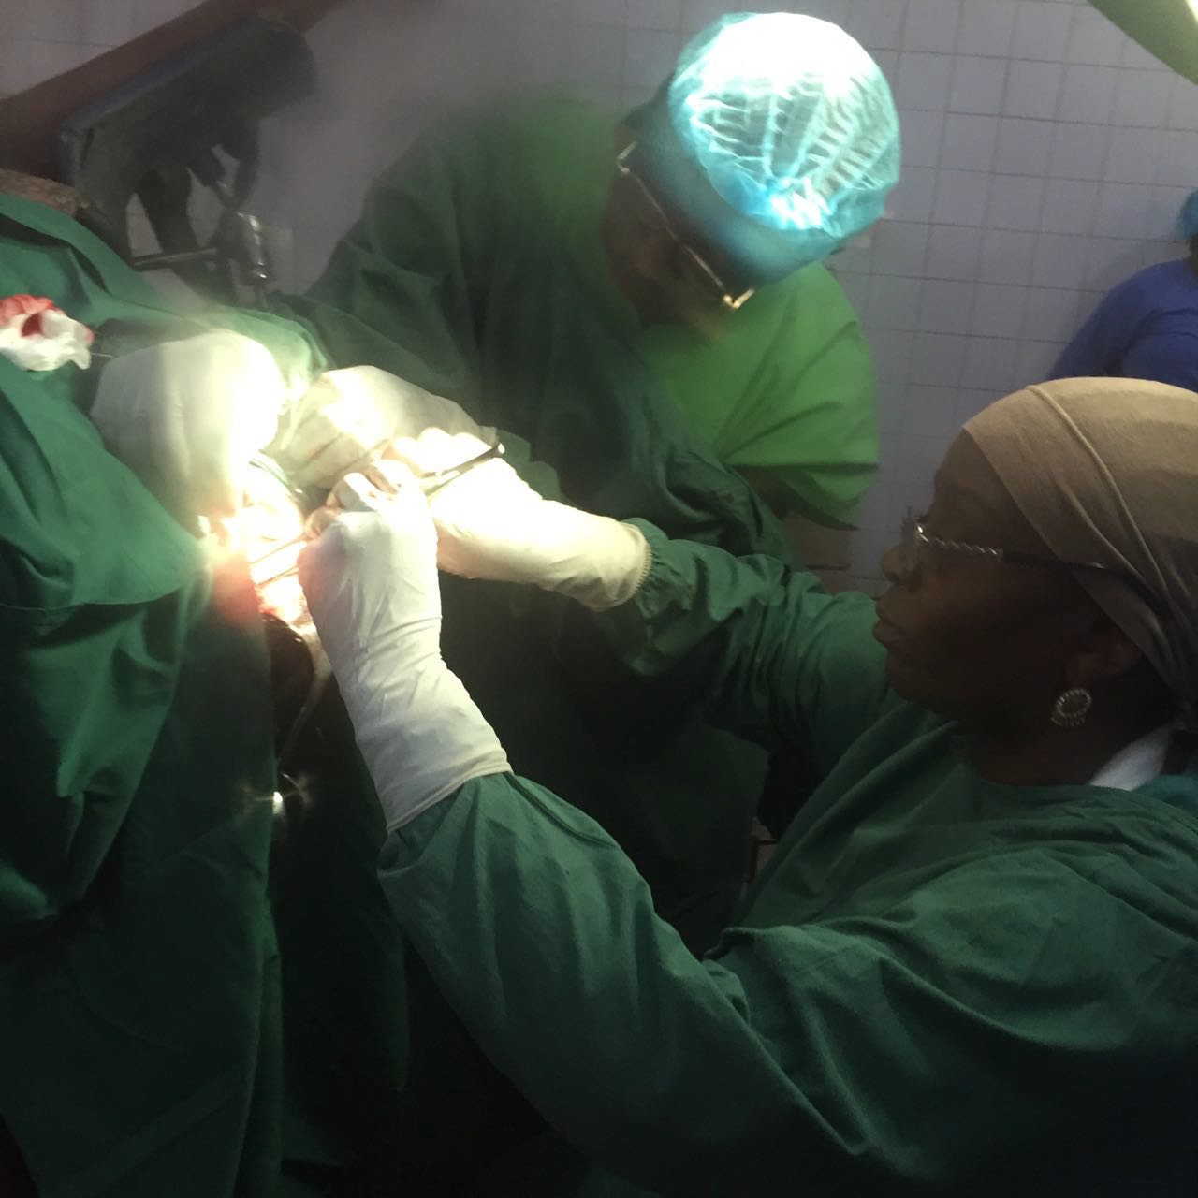
      SOKOTO CAMP (CONT’D)

Slide 41
      POST OP RECOVERY SOKOTO CAMP (CONT’D)

Slide 42
      FEEDING OF PATIENTS SOKOTO CAMP (CONT’D)

Slide 43
CONCLUSION
Organization of VVF camps can be quite challenging but worthwhile as words cannot describe the joy the patients feel when they get cured.
Collaboration with other willing partners and resource mobilization in terms of funding and materials are imperative for a successful outcome.

Slide 44
COMMENDATION/ GRATITUDE
IMA-Nigeria and the FIMA Save Dignity Project wish to extend our profound gratitude to the Jaiz Charity and Development Foundation. Jazakumullahu khairan.
The funding from Jaiz was actually the main support we had throughout these camps and this also contributed to the successful hosting of the International Conference of FIMA in 2016.

Slide 45
UPCOMING PROJECTS/ACTIVITIES
IMA-Nigeria and the FIMA Save Dignity Project will inshaAllah continue the VVF Camps as long as we have collaborations with worthy partners like Jaiz Charity and Development Foundation.
Since IMA-Nigeria is also a charity organization, in the future we hope to have a standard hospital run by Shariah principles and we hope that you will be one of our partners in this laudable project inshaAllah.
IMAN Health Facilities Consortium.

Slide 46
THANK YOU FOR YOUR ATTENTION, JAZAKUMULLAHU JANNATIL FIRDAUS, ASSALAMU ALAIKUM

Slide 47
REFERENCES
1. World Health Organization. 2015. Improving access to high quality care for obstetric fistula. http://www.who.int/reproductivehealth/topics/maternal_perinatal/fistula-study/en/
2. WHO. 2015. 10 facts on obstetric fistula. http://www.who.int/features/factfiles/obstetric_fistula/en/
3. AHMED S, O.TUNCALP. 2015. Burden of obstetric fistula: from measurement to action. The Lancet Global health. Vol 3, No 5 http://www.thelancet.com/journals/langlo/article/PIIS2214-109X(15)70105-1/fulltext
4. BABATUNDE OSOTIMEHIN. 2014. Seizing the moment to end obstetric fistula. The Lancet Global Health. Vol 2, No 7. http://www.thelancet.com/journals/langlo/article/PIIS2214-109X (14)70251-7/full text
5. FMOH. 2012. National Strategic Framework for the elimination of obstetric fistula in Nigeria 2011 – 2015. http://www.fistulacare.org/pages/da/files/5/5.4/Nigeria_National_Strategy_2011-2015.pdf
6. SNEHA BAROT. 2011. Eliminating Obstetric Fistula: a comprehensive approach to a long-ignored problem. RH reality Check. http://rhrealitycheck.org/article/2011/01/25/eliminating-obstetric-fistulacomprehensive-approachlongignored-problem/

